Slide 1


Wellbeing Moment
Aim: At the Heathland School we are committed to promoting positive mental health for every member of our staff and student body. As well as increase understanding and awareness of common mental health issues.
Every week your class teachers will share a WELLBEING MOMENT with you, to give you an opportunity to discuss your wellbeing and strategies you can employ to enhance this.
Research has found that if we build just five actions into our daily lives we can increase our wellbeing.

Slide 2
WBM Spring Term
Date | Day | Period
10.01.24 | Wednesday | Registration
19.01.24 | Friday | 2
26.01.24 | Friday | 3
02.02.24 | Friday | 4
09.02.24 | Friday | 5
HALF TERM
23.02.24 | Friday | 6
01.03.24 | Monday | 1
08.03.24 | Monday | 2
15.03.24 | Monday | 3
22.03.24 | Monday | 4

Slide 3

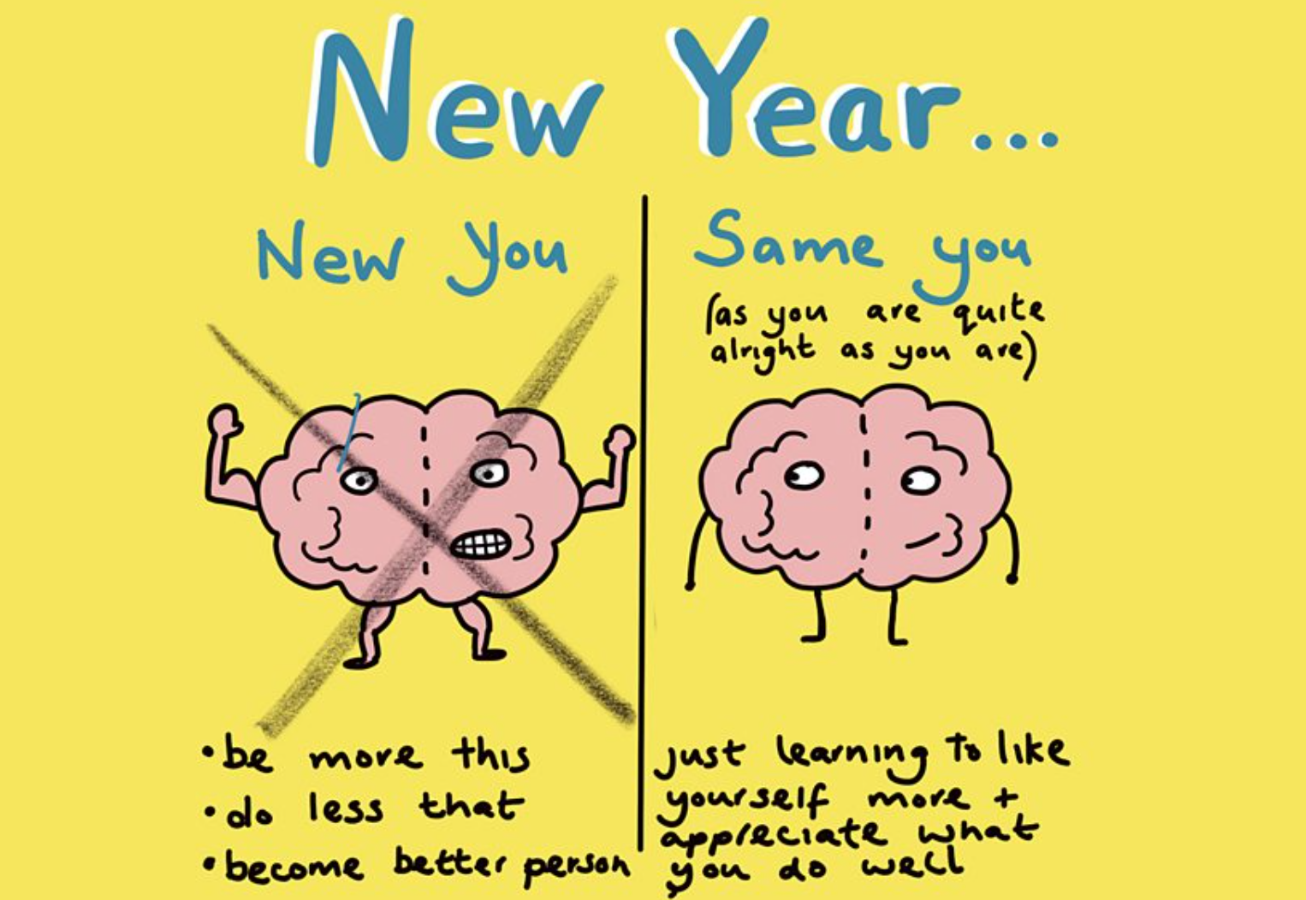
Wellbeing Moment
Happy New Year, I hope you all had a wonderful break. How many of us have made resolutions in the past and not stuck to them?
Focus on the small things instead of big goals
“The small, daily things we do have more of an impact on how we feel than achieving big goals”. “And we are also more likely to achieve small goals to develop daily habits. Think about small things you can either add (or take away!) from your day.
“I’d suggest goals such as: ‘I want to read two pages of a book a day’ or ‘I want to go for a five-minute walk a day’. These are easier to achieve and more likely to stick and motivate you to grow these into established habits.
Dr Emma Hepburn, The Psychology Mum.
This year I want you to think just about ONE SMALL GAIN that you can make to improve your everyday. Discuss what you are going to do.

