Slide 1
Parent Wellbeing Workshop
Exam Stress & Anxiety

Slide 2
Aims
To understand what causes exam anxiety and stress
To be able to identify the signs of stress in your child
Know methods to help support your child

Slide 3
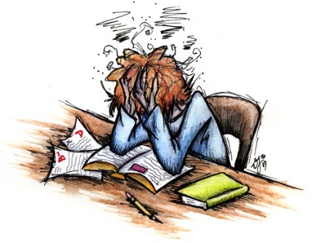
Anxiety is normal
Anxiety is a response to threat or ‘danger’. While it can feel horrible an uncomfortable, it isn’t harmful
Anxiety is normal and it’s something we use as a survival tool. In the case of exams, the right amount of anxiety allows us to focus on the exam ahead
But if we feel too much anxiety, it can impact us in different ways that aren’t so helpful

Slide 4
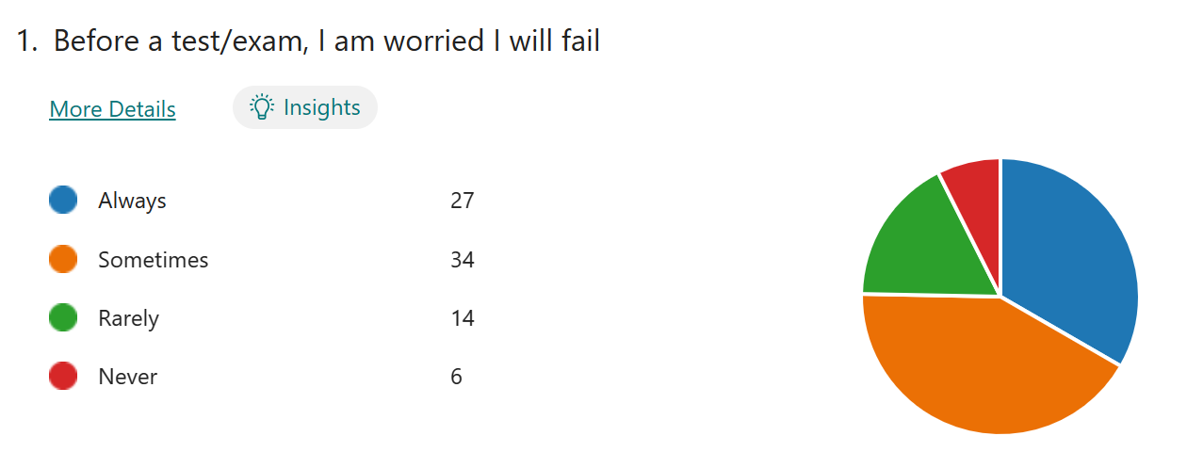
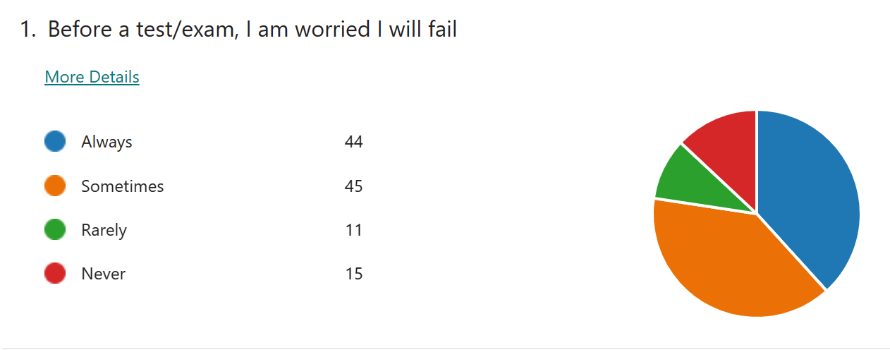
Anxiety is normal
Some students feel okay before an exam, and others can experience some level of anxiety

Slide 5
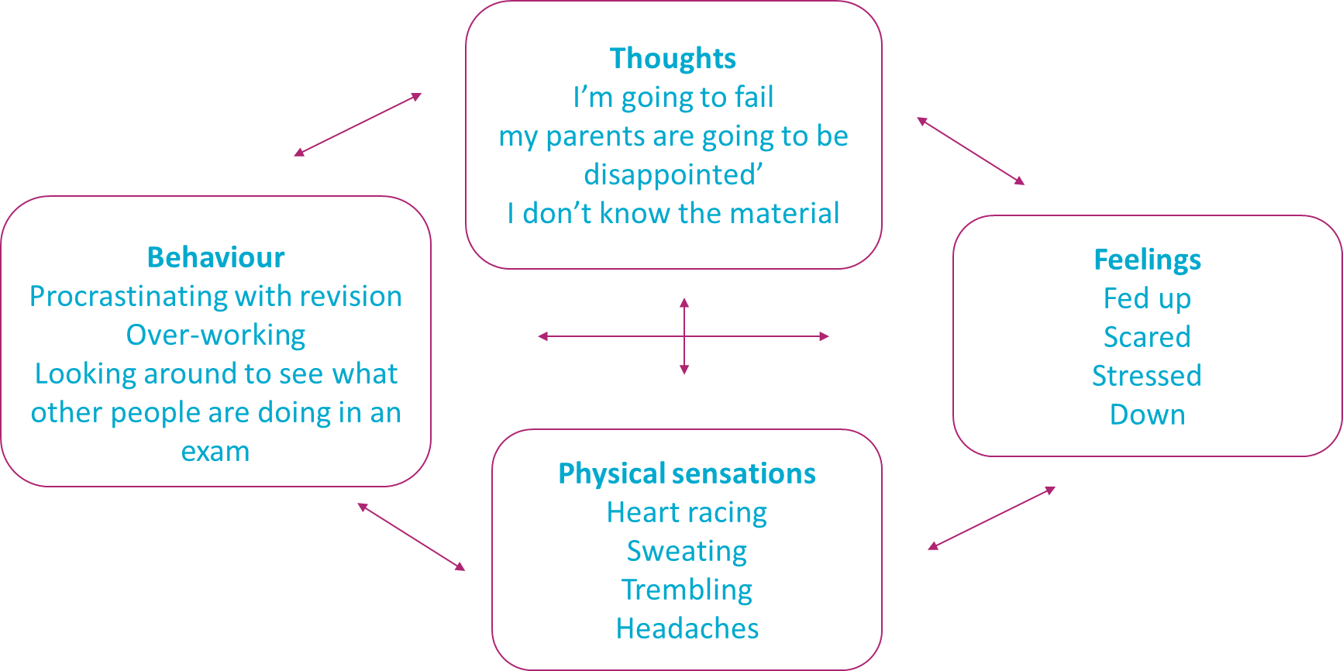
What does exam stress look like?

Slide 6
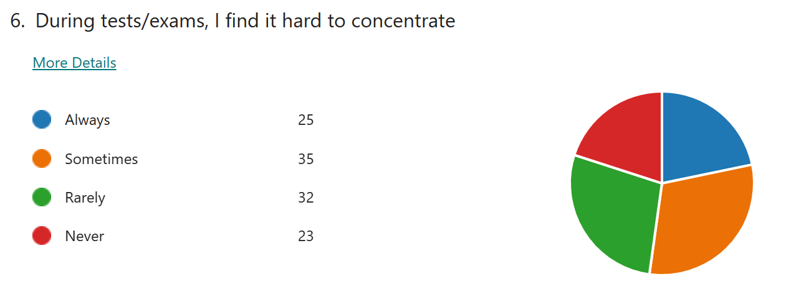
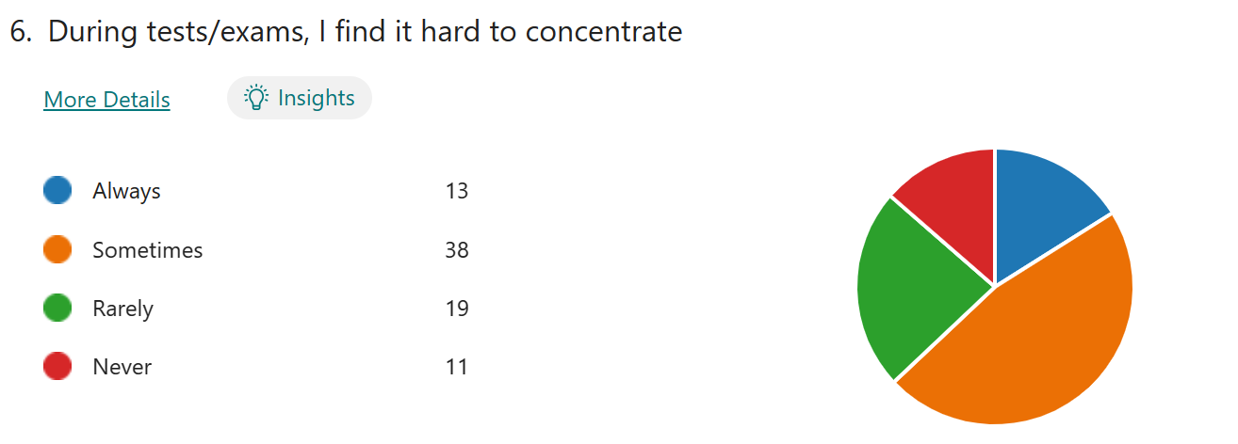

Slide 7
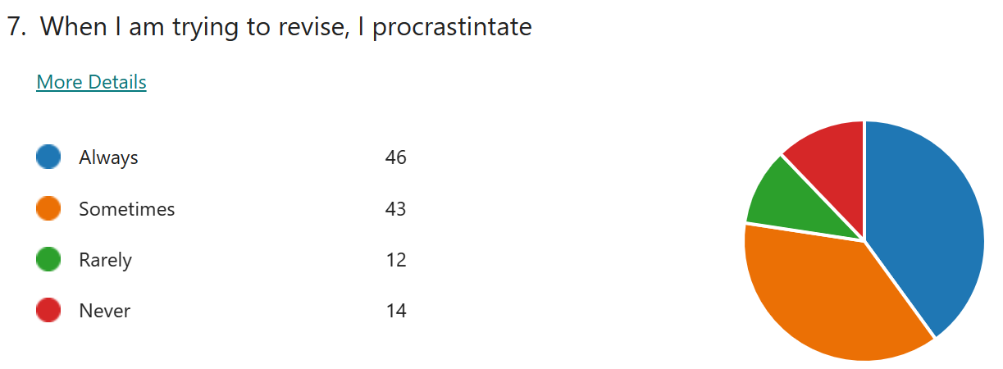
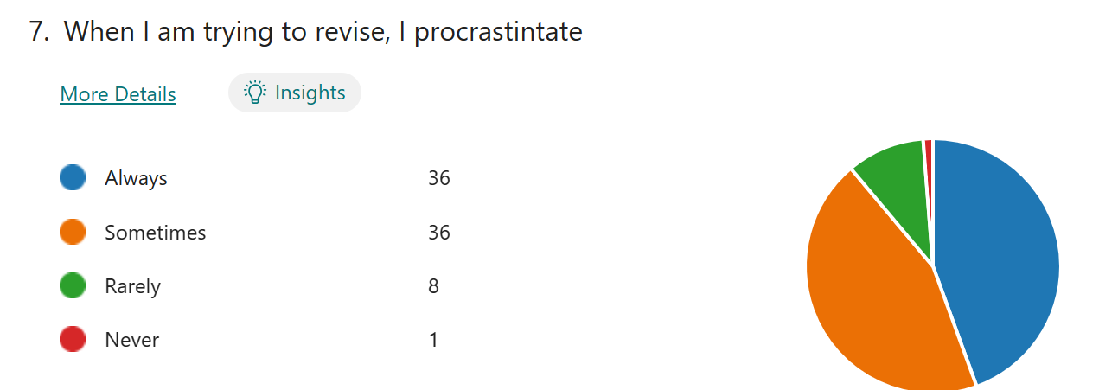

Slide 8
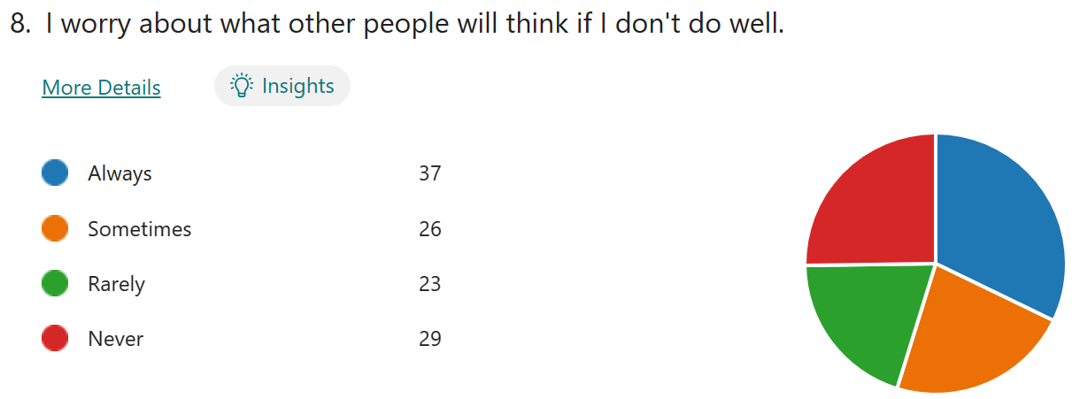
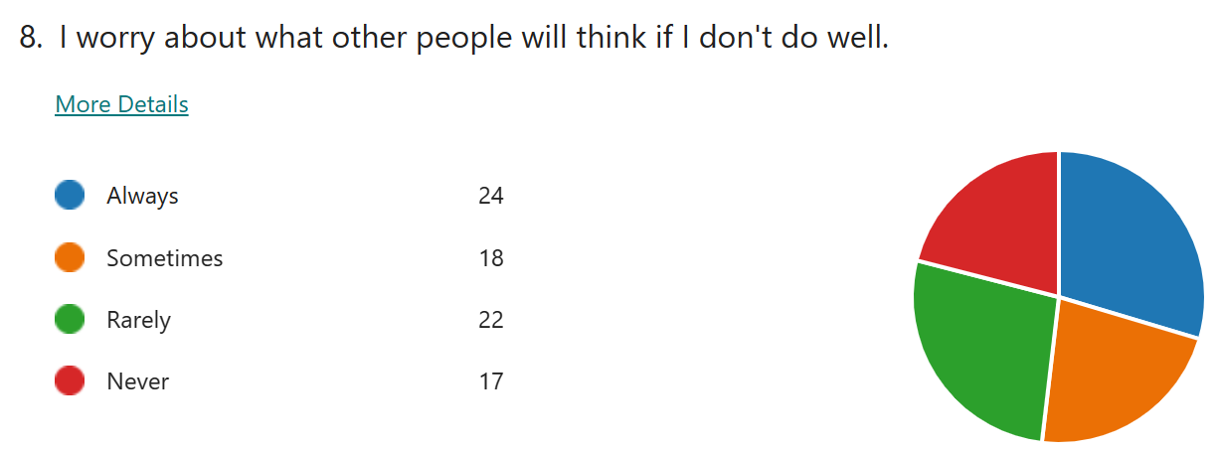

Slide 9
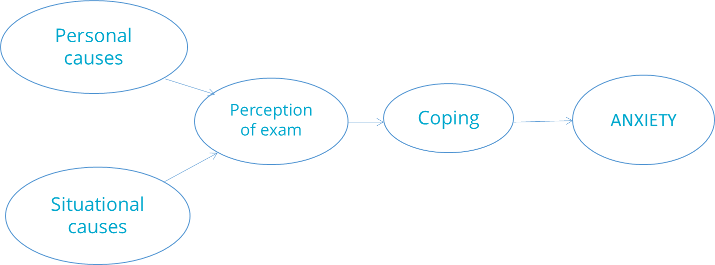
Why do students find exams stressful?
Psychologists believe that stress and anxiety come from a mixture of personal and situational causes

Slide 10
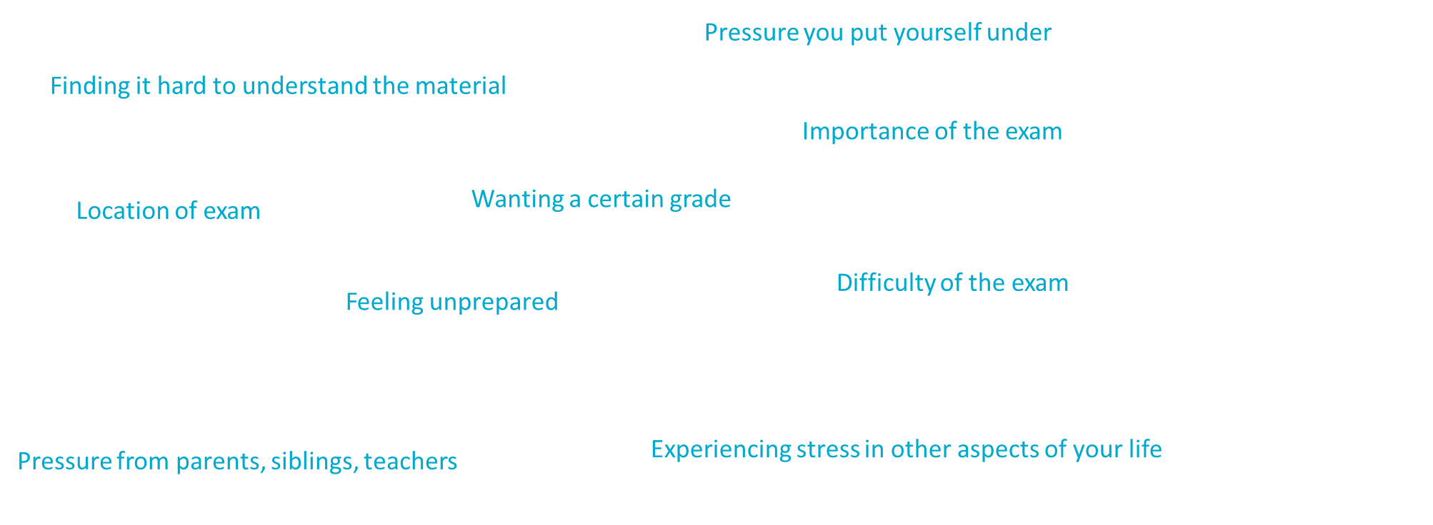
What causes exam stress?

Slide 11
What causes exam stress?
Personal Causes
Situational Causes
Pressure you put yourself under
Finding it hard to understand the material
Feeling unprepared
Wanting a certain grade
Pressure from parents, siblings, teachers
Importance of the exam
Difficulty of the exam
Location of exam
Experiencing stress in other aspects of your life

Slide 12
Why do students find exams stressful?
Psychologists believe that stress and anxiety come from a mixture of personal and situational causes

Slide 13
What is keeping exam stress going?
Thoughts
e.g. ‘I’m going to fail’ ‘my parents are going to be disappointed’
Behaviour
e.g.
Procrastinating with revision
Over-working
Feelings
e.g. Fed up
Stressed
Physical sensations
e.g. Heart racing
Sweating

Slide 14
What might be the indicators that your child is stressed?

Slide 15

What does your child worry about?
Notes:
2 to 3 main fears or worries on post-its

Slide 16
Worry a lot
Feel tense
Have headaches
Not sleep well
Be irritable
Lose interest in food
Eat more than usual
Not enjoy activities
Be negative
Low mood
Feel hopeless

Slide 17
Helping your child manage their fears and worries

Slide 18
What keeps those worries going?
= How children respond to situations
= How parents respond to their worries

Slide 19
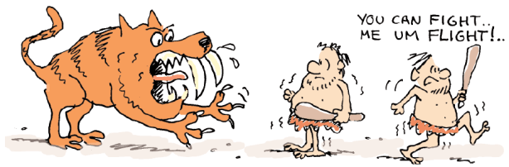
Worry creates…
  1) Anxious behaviours
    Behaviour aimed at helping the child anticipate and/or avoid future danger, e.g. looking out for danger (hypervigilance), avoiding worrying situations

Slide 20
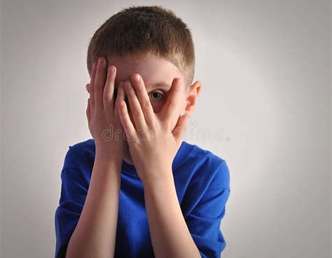
What are your child’s anxious behaviours?
Avoidance is common
Seeking reassurance
They may overestimate the danger but underestimate their ability to cope….
Physical
Thoughts
Behaviour
Feelings

Slide 21

Building up brave behaviour
Encourage independence and a can-do attitude
  Praise effort/having a go
  Reward non-anxious behaviours
Gradually build up to facing the worry
  Make a step by step plan (baby steps)
  Develop steps and rewards with your child

Slide 22
Worry creates…
  2) Anxious thoughts
    Over-estimate “danger”; underestimate ability to cope
    “Worry” – similar worries exist in “clinical” and “non-clinical” populations (e.g. school, health, personal harm, friendships)

Slide 23

Negative Thoughts
Overestimating likelihood of danger + underestimating your ability to cope
Negative Automatic Thoughts (NATs)
Exaggerated – thinking that if something bad happens in one situation then it is likely to happen in all situations
Perfectionist – thinking that things are not acceptable if they’re not perfect
Catastrophic – thinking that the worst possible thing is going to happen

Slide 24
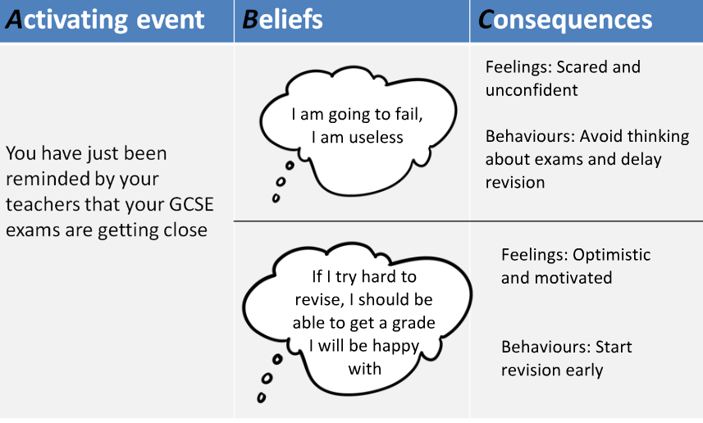
Why do thoughts matter?

Slide 25
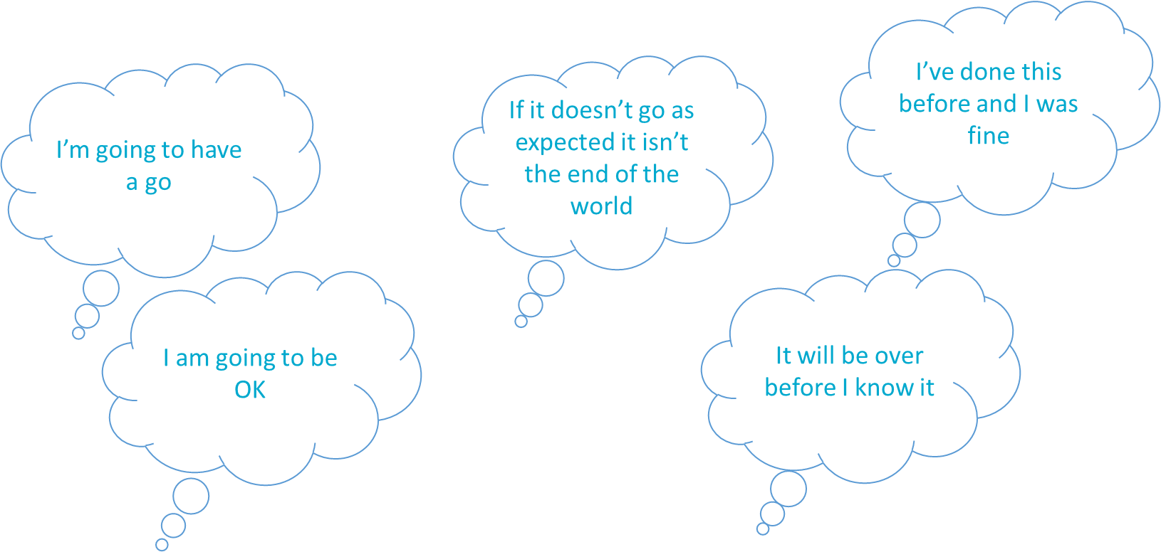
Targeting Negative Thoughts
Change their thoughts to positive ones
e.g. before an exam:

Slide 26
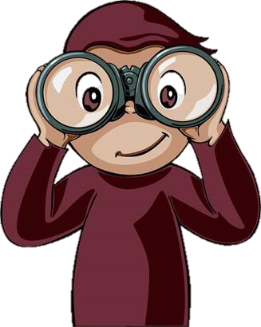
Learning to spot your child’s anxious thoughts
Don’t assume you know…
Be curious/interested, ask open questions but don’t be intrusive
Sometimes there is a clear link between their worry and their behaviour; at other times even they may not understand
Empathise: being able to share their fears/worries may make them feel less alone with those emotions
Thoughts
Physical
Behaviour
Feelings

Slide 27

Exploring anxious thoughts
Ask your child:
Are your worries likely to happen?
Are your thoughts helpful?
How else might we think about it?
How can we test your thoughts out?
We use a technique called
JUDGE AND JURY….

Slide 28
Weighing up the anxious thought (what is most upsetting my child?)
Factual evidence to support the thought (the defence)
?
?
?
?
?
?
?
Factual evidence against the thought (the prosecution)
?
?
?
?
?
?
?
Judge weighs up facts and makes a balanced judgement
Notes:
We use this method to help children to think about their own thoughts. Sometimes, when we are very worried/stressed we cant think straight and have unhelpful ways of thinking. It’s a little bit like wearing a different pair of glasses that we see the world through, for example thinking the worst or thinking we know what others are thinking about us (mind-reading). Judge and jury is a way of taking a step back from the thoughts and trying to find a more balanced way of thinking about the situation.
Try weighing up Sam’s anxious thought that “all dogs are dangerous” but try to stick to the facts only!
Left hand side of the room to come up with some facts that support the thought “all dogs are dangerous”
Right hand side of the room to come up with some facts against the thought that “all dogs are dangerous”. Then the judge will decide which side wins on the basis of the evidence presented.

Slide 29
Worry creates…
  3) Physical sensations in the body
    Associated with adrenalin - preparing the body for action
    e.g. sweating, heart beats faster, shivering (these can be frightening)

Slide 30
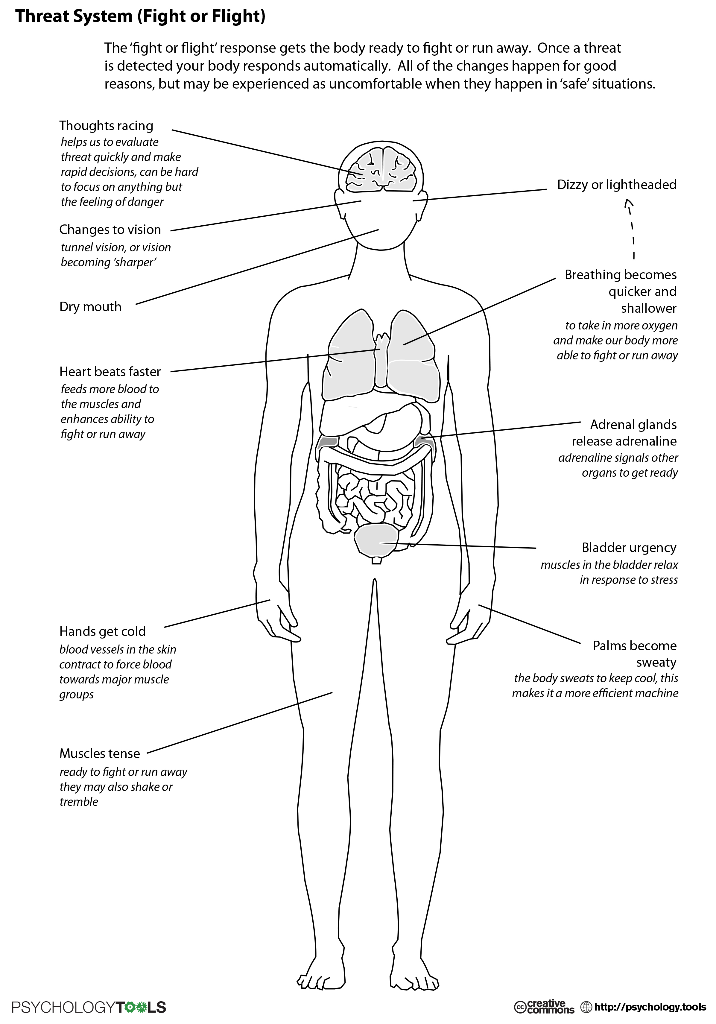
What are the physical symptoms of their worry?
Circle the ones that apply to your child
Physical
Thoughts
Feelings
Behaviour

Slide 31
Helping your child manage physical symptoms of worry
Relaxation techniques:
  5 things I can see, 4 things I can touch, 3 things I can hear, 2 things I can smell and 1 thing I can taste.
  Breathing exercise
  Progressive muscle relaxation, “Journey through the body”
  Mindfulness
  Visualisations, eg flowing river, drop your worries in and let them flow away.
Notes:
Give out handout with links to relaxation techniques to try at home

Slide 32
Ways to help. Parent support video
Balanced diet
Plenty of sleep (8-10 hours) – remove phones from the bedroom
Be flexible - do not worry about household jobs
Stay calm (they don’t last for ever!)
Help them study – desk, quiet space, revision schedule
Talk to them
Encourage exercise during exams
Do not add pressure
Notes:
Support group Childline says many children who contact them feel that most pressure at exam time comes from their family.
Listen to your child, give them support and avoid criticism.
Before they go in for a test or exam, be reassuring and positive. Let them know that failing is not the end of the world. If things do not go well they may be able to take the exam again.
After each exam, encourage your child to talk it through with you. Discuss the parts that went well rather than focusing on the questions they found difficult. Then move on and focus on the next test, rather than dwelling on things that cannot be changed.

Slide 33
What are school doing?
Exam stress questionnaire
Exam support groups
Strategies to deal with exam pressure and stress (STEPS) groups
Revision techniques in tutorial
Strategies shared in tutorial – e.g. procrastination

Slide 34
Further support
Exam stress - How can parents help? - BBC Bitesize
Parents Mental Health Support | Advice for Your Child | YoungMinds
Exam stress and failure | Parentkind
Information for 11-18 year olds – Exam stress – Mind
Exam stress and pressure | Childline
Help your child beat exam stress - NHS (www.nhs.uk)

