Slide 1
AQA: A Level English Literature Curriculum

Slide 2
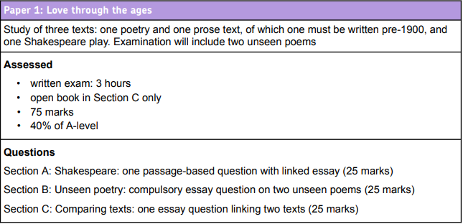
Our choices of texts:
Section A: Shakespeare – Othello (closed book exam)
Section B: Unseen Poetry – an anthology of unseen poetry is being prepared (two unseen poems in exam)
Section C: AQA Anthology of pre-1900 Poetry compared with F Scott Fitzgerald’s The Great Gatsby

Slide 3
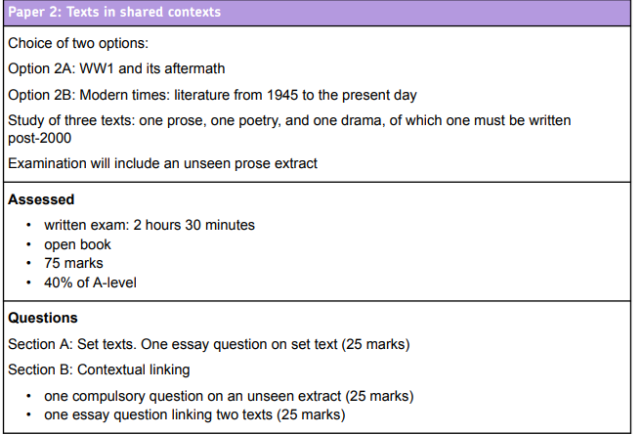
Our choice: Option 2B: Modern Times: Literature from 1945 to the Present Day
Section A set text choice: Prose – Atwood’s The Handmaid’s Tale
Section B1: Unseen Prose Extract (practice on anthology of extracts)
Section B2: Drama and poetry on chosen texts: Tennessee Williams’ A Streetcar Named Desire & Carol Ann Duffy’s ‘Feminine Gospels’
The Handmaid’s Tale
Unseen Prose Extract
A Streetcar Named Desire & ‘Feminine Gospels’

Slide 4
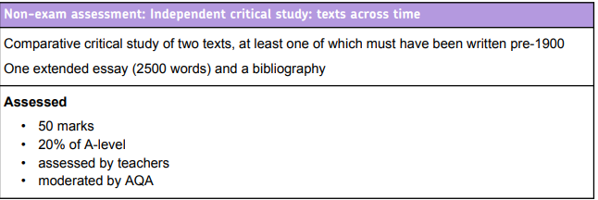
These texts will be Pride and Prejudice and your choice from a menu of second texts (tbc each year by teachers)

