Slide 1
AQA: A Level Media Studies Curriculum

Slide 2
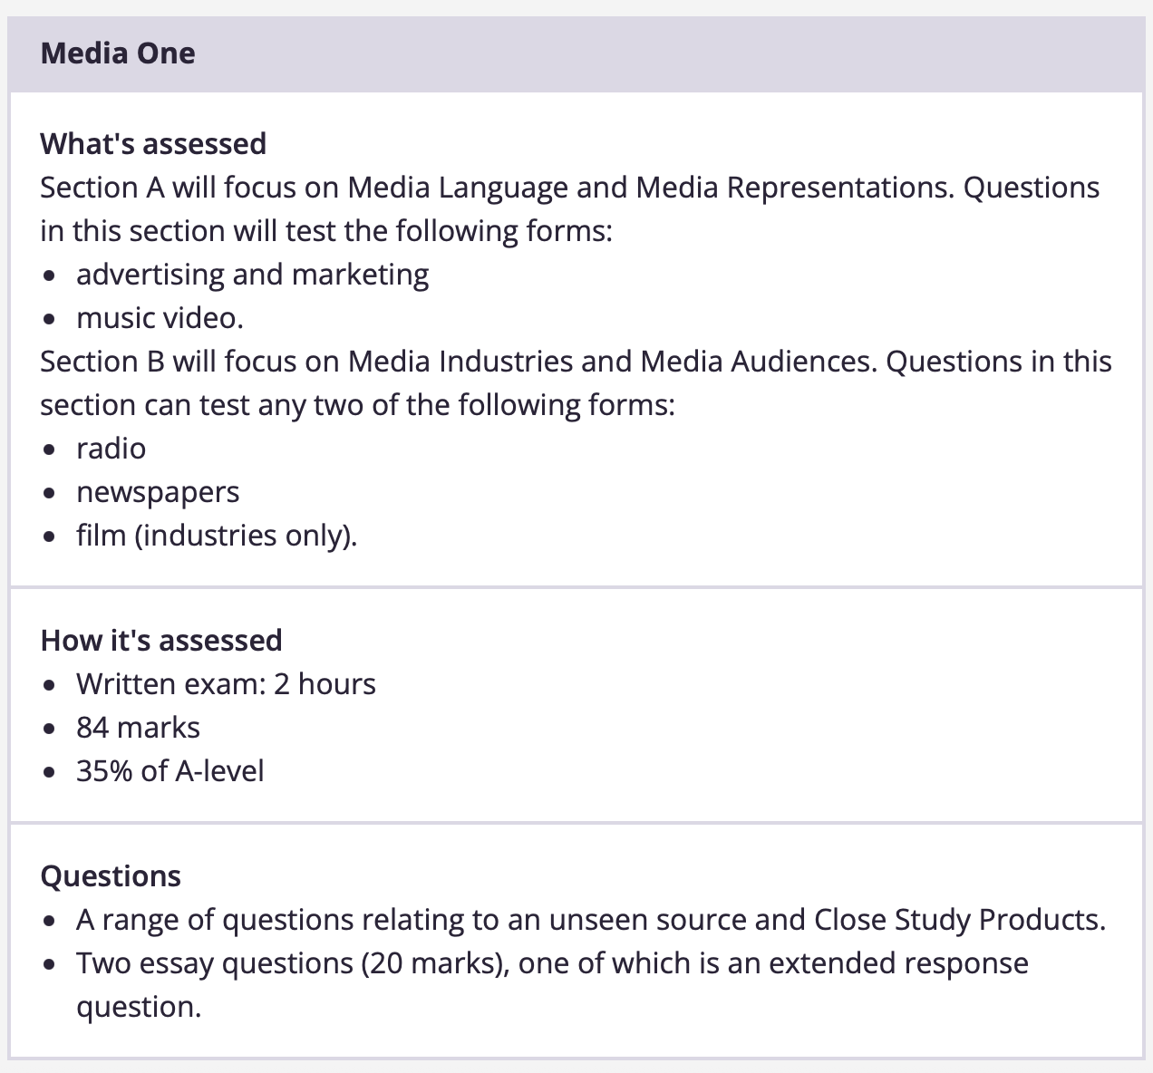

Slide 3
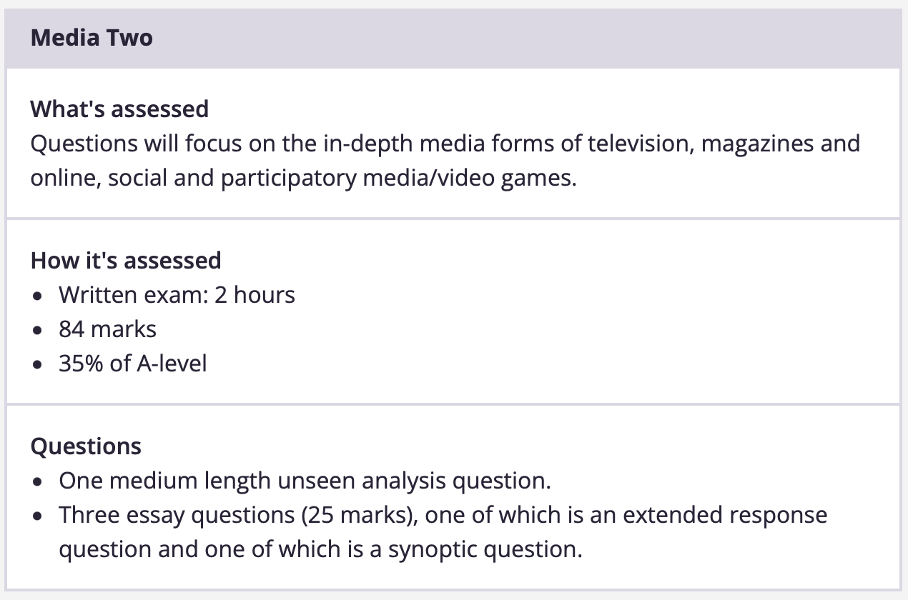

Slide 4
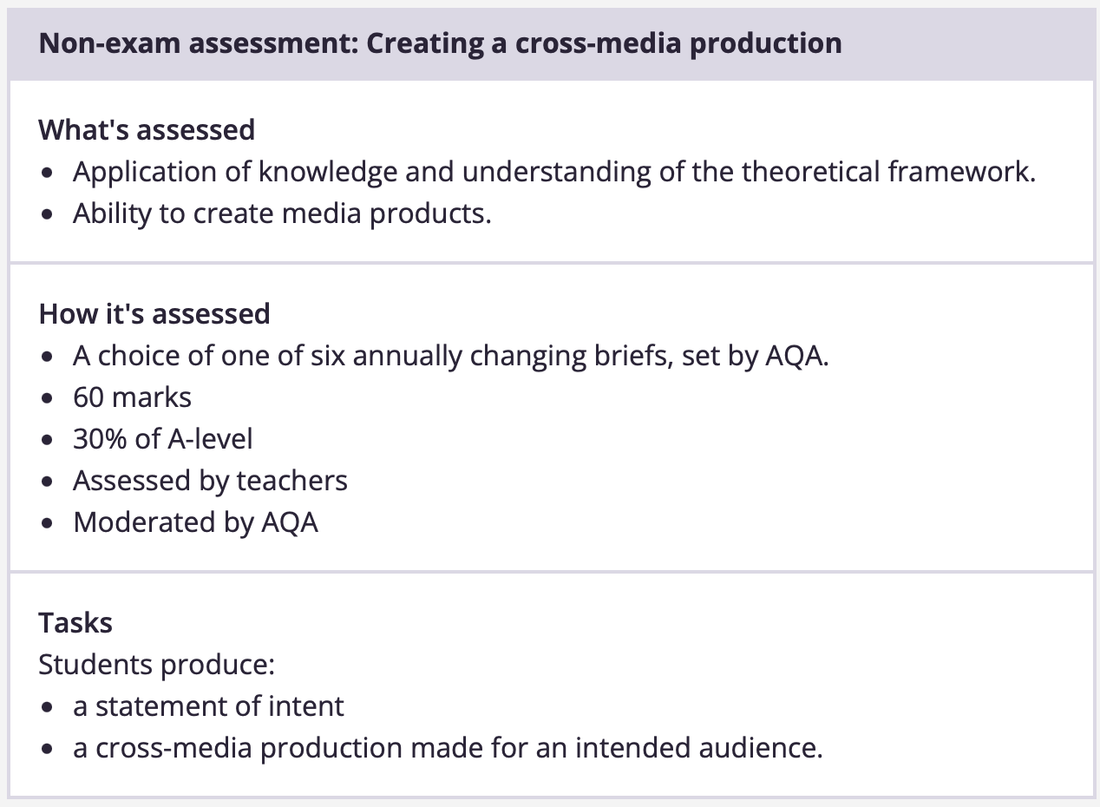

Slide 6
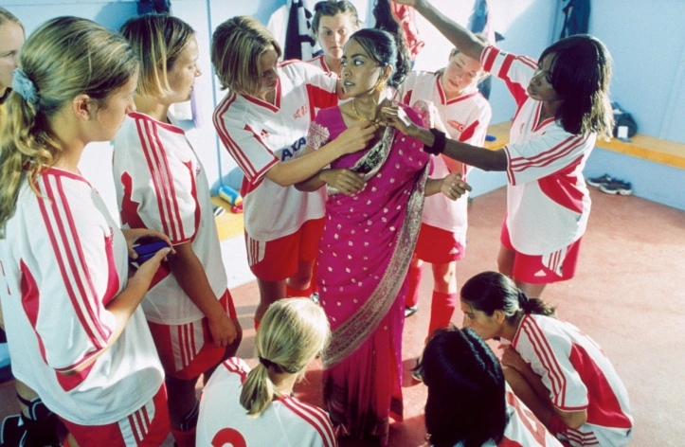
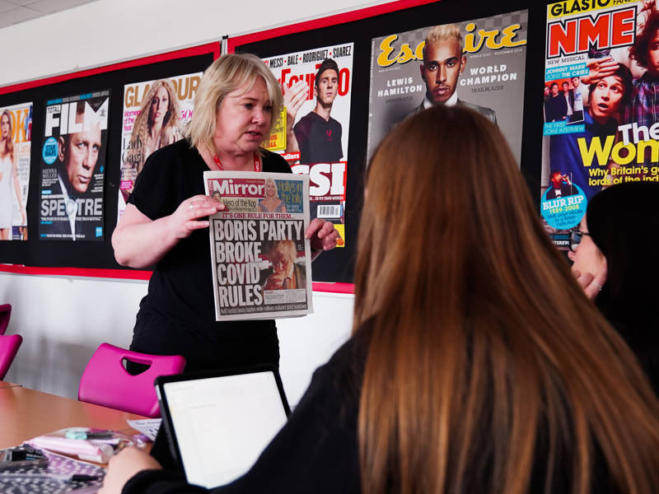

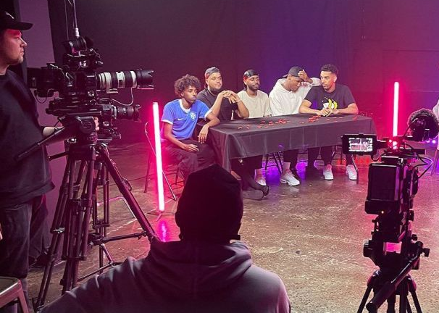
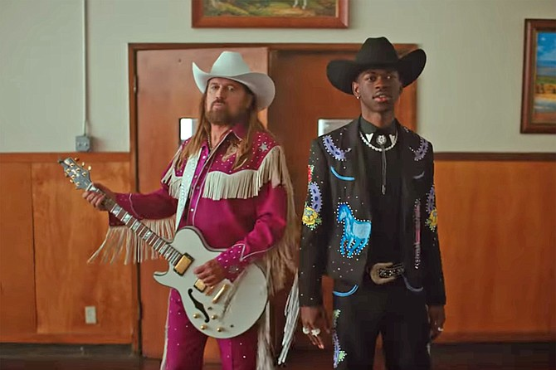
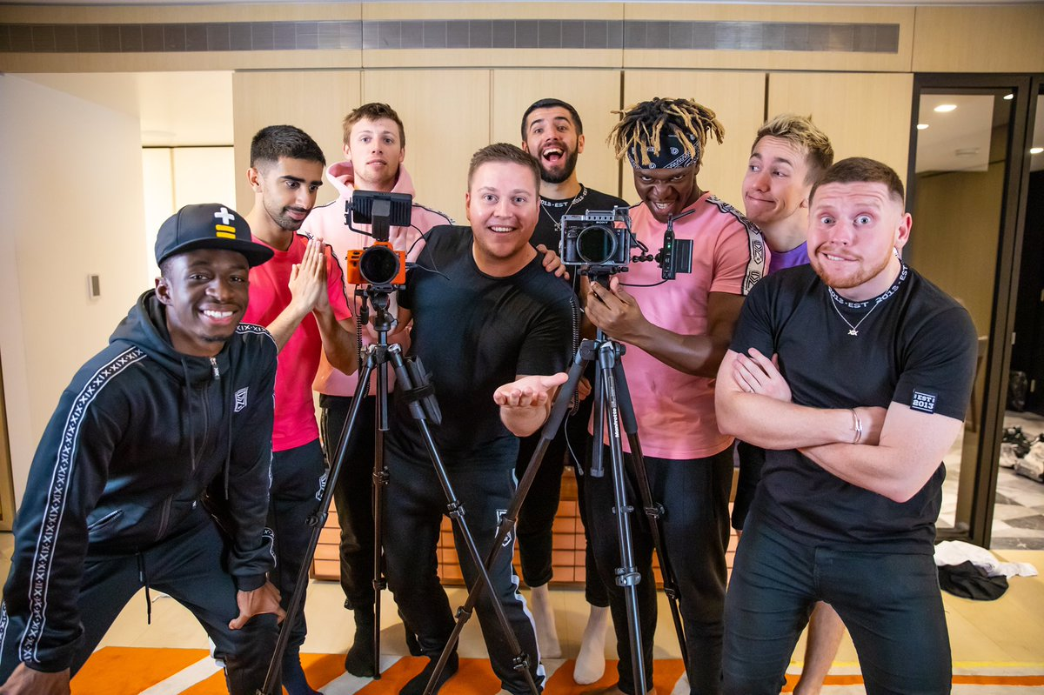
A Level Media Studies
AQA A-Level Media Studies explores how media—like film, TV, social media, advertising, and video games—shapes our world. Students analyse real-world examples, learning about audience behaviour, media representation, and industry practices.
The course combines academic study with practical skills, such as creating your own media projects (e.g., short films or social media campaigns).
Key topics include:
Representation of gender, race, and culture in media.
Media production techniques and tools.
The role of media in politics, business, and society.
This course builds critical thinking, creativity, and communication skills, preparing students for diverse fields such as marketing, law, business, or even STEM careers with a creative edge.
In a world driven by media, wouldn’t you want to know how to master it?
Notes:
MYS

Slide 7
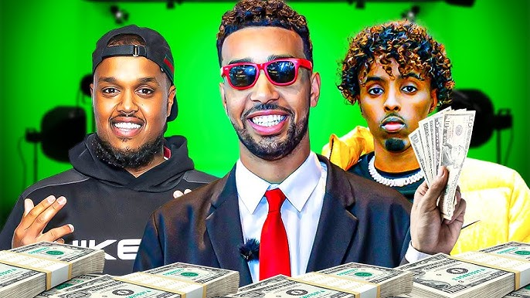

Why study A Level Media Studies?
1. Learn About the Media that Shapes Your World
Media influences everything: politics, culture, fashion, and even the way we think. In this course, you’ll analyse films, TV shows, social media, video games, and advertising to understand how and why they impact society.
2. Gain Transferable Skills for Top Careers
Develop skills in critical thinking, research, problem-solving, and creativity—skills highly valued in law, marketing, PR, business, and beyond.
Explore media production by creating your own film clips, magazines, or social media campaigns, which are perfect for building portfolios for creative or business-related university courses.
3. Keep Your Options Open
Media studies complements traditional STEM and business pathways by teaching you about brand management, consumer psychology, and how to communicate effectively in a digital-first world.
A unique edge for careers like medicine or dentistry, where understanding patient communication or branding a private practice matters.
4. Study Exciting, Relevant Topics
Analyse real-world case studies like Marvel films, TikTok trends, or Netflix’s global success.
Discuss topics like how gender, race, and culture are represented in media—issues that resonate with minority communities.
5. Stand Out in a Competitive World
Employers and universities love students with diverse perspectives. Media studies proves you're adaptable, creative, and globally aware.
Notes:
MYS

Slide 8
A Level Media Studies – Destinations
Student Name | A Level | A Level | A Level | Degree | University
Manveer Hakemzadeh | Media Studies | Economics | Psychology | Film Studies | King's College London
Nadir Rahman | Media Studies | Economics | Business Studies | Law | Royal Holloway
Manveer Wahda | Media Studies | Photography | Spanish | Film, Television and Digital Production | Royal Holloway
Owen Carter | Media Studies | English Literature | History | Film and Media | University of Kent
Diogo Andrade | Media Studies | Sociology | Spanish | Sports Journalism | Southampton Solent University
Zaira Malik | Media Studies | Business Studies | RS | Media Studies and Analogy | Goldsmith's University London
Notes:
MYS

