Slide 1
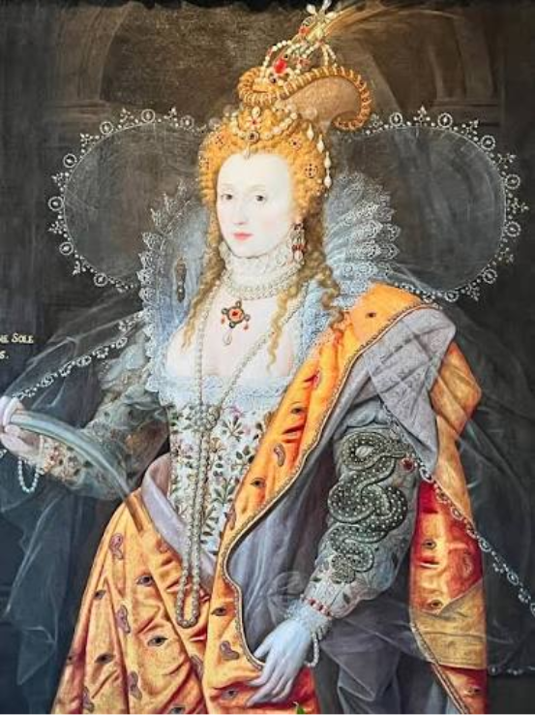
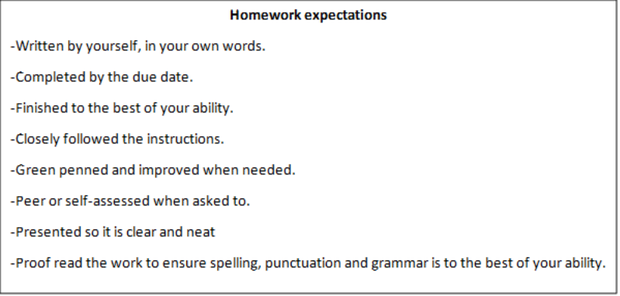
Year 8 Homework project
Autumn term 2: 16th-18th Century Art

Slide 2
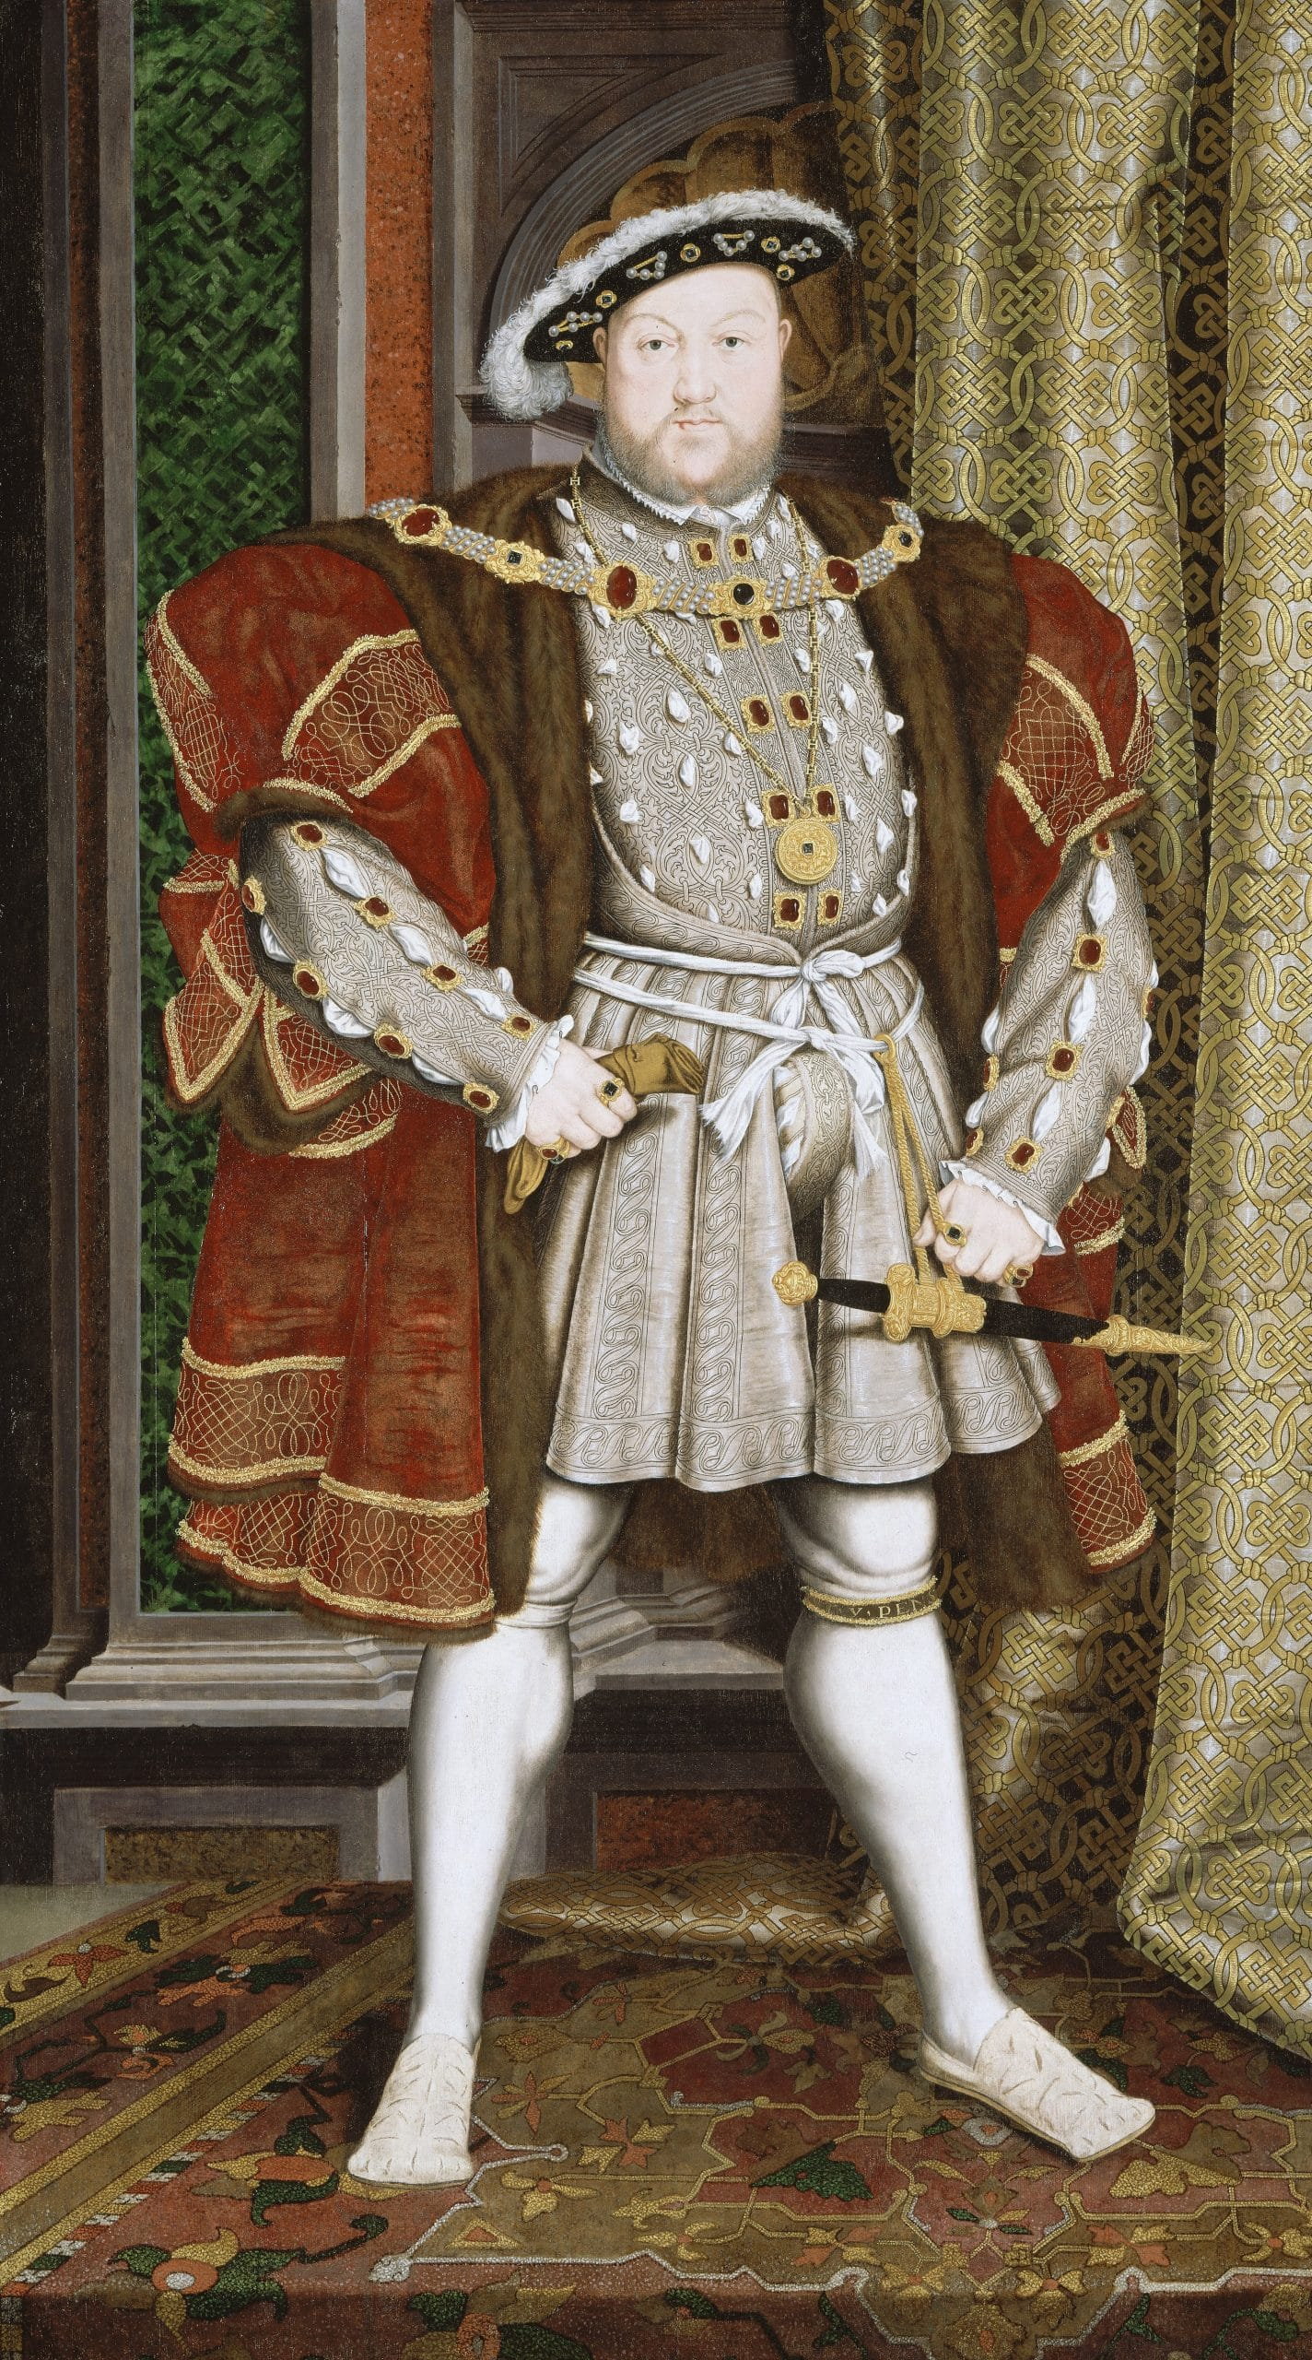


Task one – Portrait Analysis
​
During the 15th to 17th centuries, art in Britain was not just for decoration; it was a powerful tool for survival, politics, and social status. This era spanned the Wars of the Roses, the Tudor and Stuart dynasties, and the English Civil War, making visual communication vital. ​
Look at the portrait of Henry VIII below painted in 1537. Where there are lines, research and fill out what the different parts of the painting represent and annotate the portrait. ​
​
Medallion:
Posture:
Clenching a glove:
Dagger:
Due Date:

Slide 3
Task Two – Retrieval Practice
​
Who was at the top of Tudor and Stuart society?
____________________________________________________________________________________________________________________
2. Who was at the bottom of Tudor and Stuart Society?
____________________________________________________________________________________________________________________
3. In 60 words describe what it would have been like for a poor person living in the 17th century:
____________________________________________________________________________________________________________________________________________________________________________________________________________________________________________________________________________________________________________________________________________________________
4. Who was John Blanke and what did he do?
______________________________________________________________________________________________________________________________________________________________________________
5. Who was Mary Filis and what did she do?
______________________________________________________________________________________________________________________________________________________________________________
6. Was life easy being LGBTQ+ in Early Modern England? Why?
________________________________________________________________________________________________________________________________________________________________________________________________________________________________________
7. Who was Katherine Howard?
__________________________________________________________
8. How did Katherine Howard die?
__________________________________________________________
Due Date:
Teacher Assessed

Slide 4
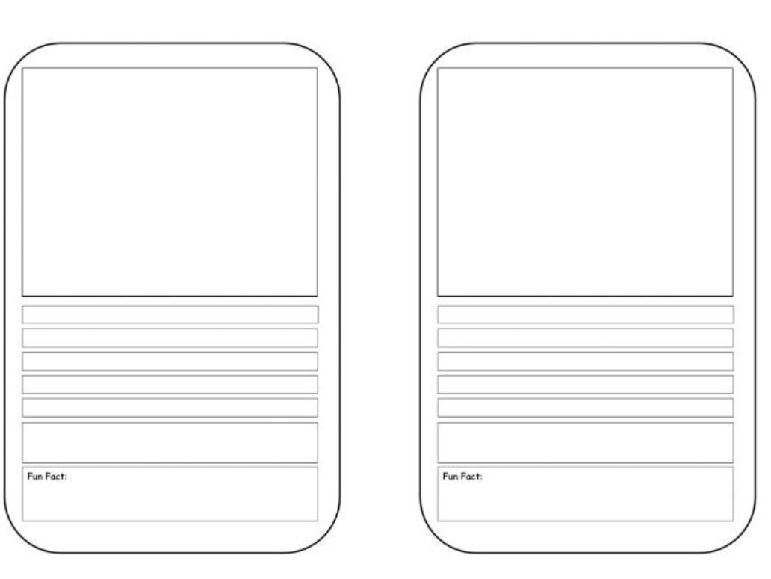
Task three – 17th Century Artists
In the 17th century, art in Europe was strongly influenced by power, religion and wealth. Many artists focused on realistic portraits and dramatic scenes for example a battle in the Civil War.
You are going to research and fill out fact files on two famous European artists: Anthony Van Dyck and William Dobson.
Include:
Who they were and when they were alive
A name of a famous painting they created
A picture of either them or one of their paitnings
A fun fact
Due Date:
Peer Assessed

Slide 5
Due Date:
Task four – Retrieval task
You completed two lessons research who Katherine Howard was, why she was vulnerable and whether she was responsible for her execution ordered by her husband, Henry VIII.
Using your research in that lesson complete the activities below:
Define the word vulnerable:
__________________________________________________________________________________________________________________
Reasons why Katherine Howard was responsible for her execution
Reasons why Katherine Howard was not responsible for her execution
Self-Assessed

Slide 6
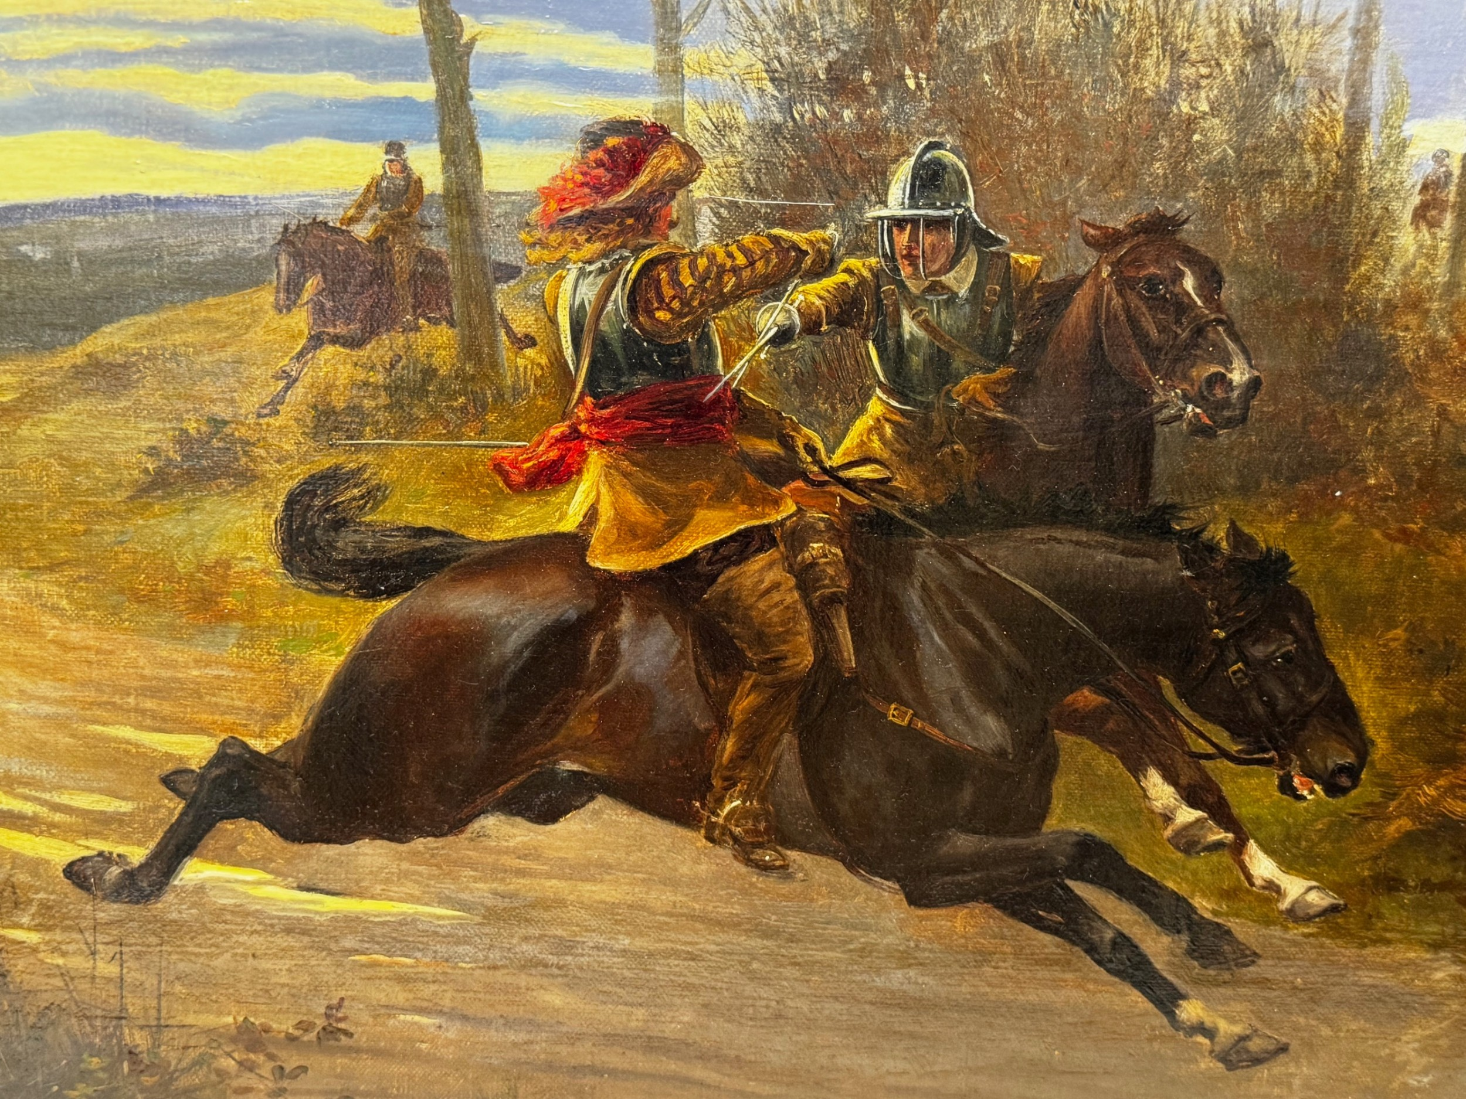
Task five – 17th Century war painting.
During the time of the Civil War (1642-1651), paintings were important because they helped show power, loyalty between the two sides and identity. Portraits of the king, his supporters and leading figures were used to promote Royalists and the power of the monarchy. Artists like William Dobson who you research in task three would create paintings of the king and his soldiers to recruit new soldiers and show strength. Paintings were the only way for people to visualise what the fighting was like and understand what was really happening across the country.
Look at the war painting below created in 1645. Next to the painting, draw your own 17th century painting representing a battle in the civil war, think about the armour soldiers were wearing, the ammunition they would have had and try and keep it as realistic to the time period as possible and give your painting a name
Due Date:
Teacher Assessed

Slide 7
Task six – Retrieval task
Due Date:
What are two reasons why women were accused of Witchcraft?
____________________________________________________________________________________________________________________________________________________________________________________________________________________________________
2. How were witches executed?
________________________________________________________________________________________________________________________________
3. Name three jobs poor people did in 16-17th Britain:
___________________________________________________________________________________________________________________________________________________________________________
4. Name three sports created in 16-17th century Britain:
___________________________________________________________________________________________________________________________________________________________________________
5. Why were portraits so important to monarchs?
_____________________________________________________________________________________________________________________________________________________________________________________________________________________________________________________________________________________________
6. Which children were able to go to school in this time-period?
__________________________________________________________________________________________________________________
7. What was the purpose of newspapers and magazines in this time-period?
__________________________________________________________________________________________________________________
8. Could always trust what newspapers and magazines wrote? Why?
__________________________________________________________________________________________________________________
Peer Assessed

