Slide 1

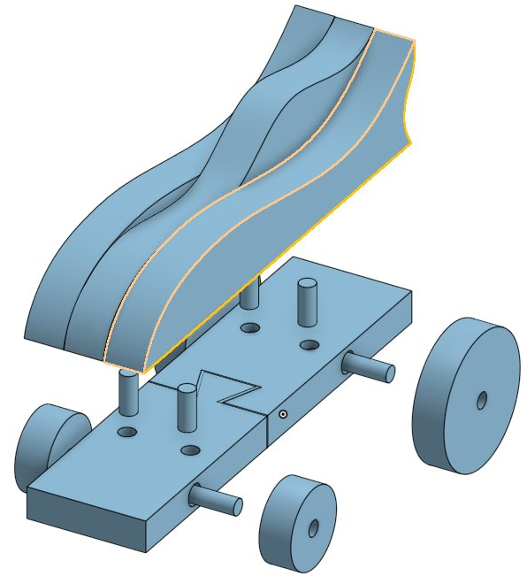
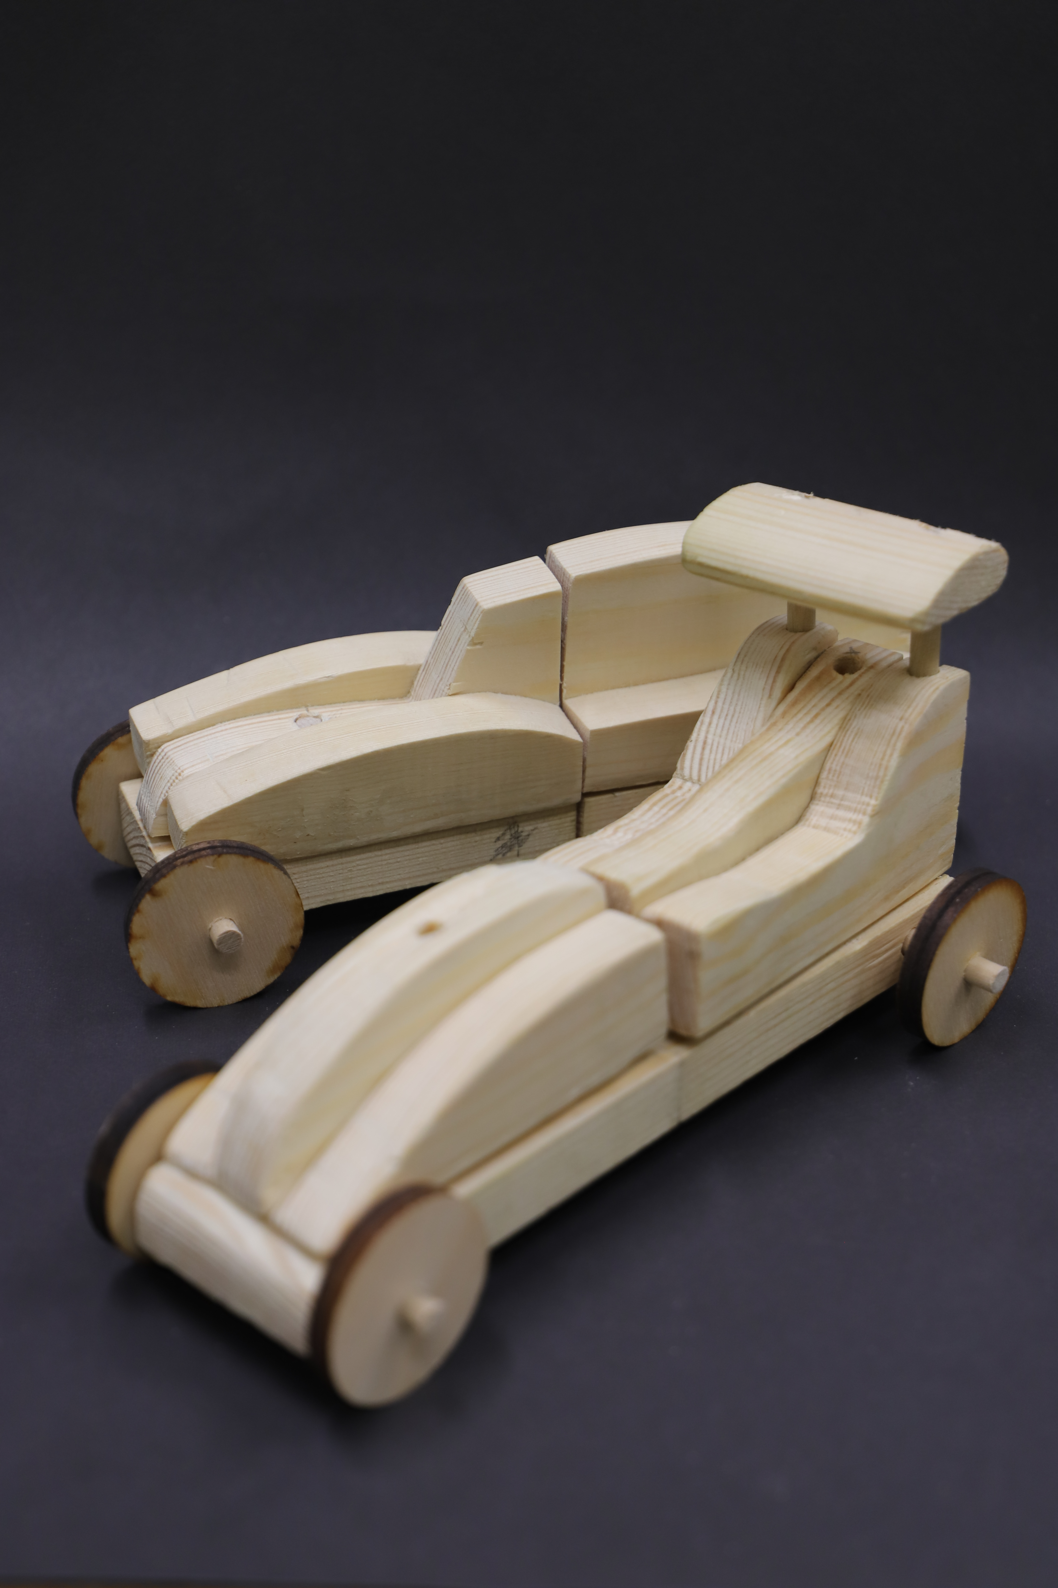


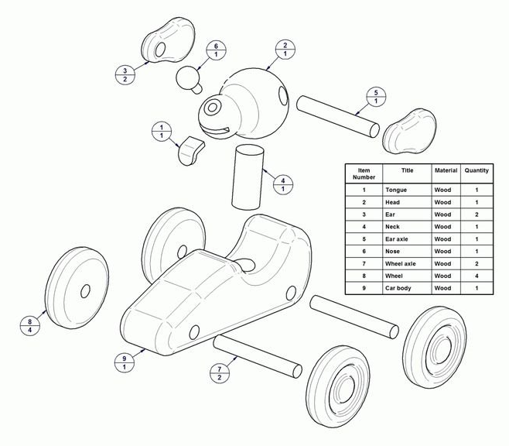
Year 8 Design and Technology: Wood Joints Project | Your Name:
Home Learning Booklet | Teachers Name:
Autumn Term | Class Code:
Home learning expectations: Work must be drawn or written by yourself, in your own words. Completed by the due date. Finished to the best of your ability. Closely follow the instructions. Green penned and improved when needed. Peer or self-assessed when asked to. Presented so it is clear and neat Proof-read the work to ensure spelling, punctuation and grammar is to the best of your ability.
DEDICATION

Slide 2

Home learning Task 01: Ideas research
To design your self-assembly product using wood joints you are going to need images that you can use for inspiration On this page arrange at least 20 images from a theme of your choice Avoid images of wooden toys and look instead for real objects on a theme. Make sure you can clearly see all of the images as you will need to use them to design from (don't stick them on top of each other). You can use the school printers
Some ideas
Racing cars lorries/trucks/vans Aeroplanes/jets/propellor planes Space rockets Exotic animals and birds Plants/tress/flowers
Teacher Assessment: | WWW: | EBI:
Self Assessment: | WWW: | EBI:

Slide 3
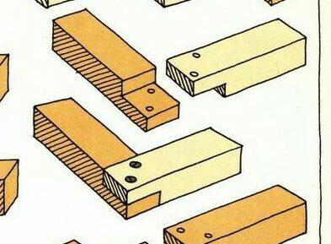
Home Learning Task 2: Materials research
Create a page about Pine (the wood you will be using to make your self-assembly construction product) and some construction methods you could use.. You are going to hand write it and draw into your booklet so no AI or copy and paste.
Answer the following questions:
Where does Pine come from and which part of the world is it most common? What is the structure of pine? (find a diagrams online and reproduce it) Find an example of a wood joint and draw it in the space provided Find an example of a wood joint in your home and draw it
Question 01:
Question 03:
Question 04:
Question 02:
Self Assessment: | WWW: | EBI:

Slide 4
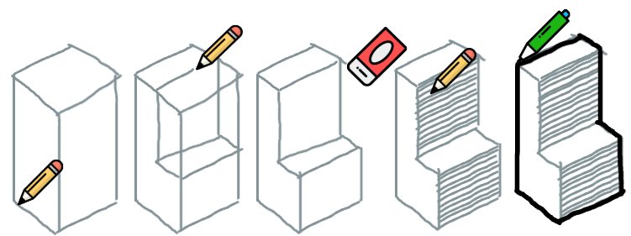
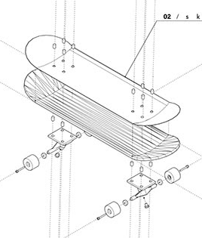
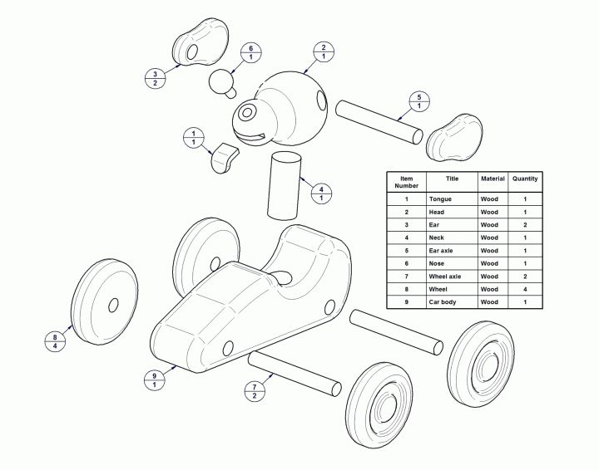
Home Learning 3: Complete Design Ideas
Task 01:
You now need to complete the ideas for your self-assembly product Follow the guidance on this page to complete your diagrams on your A4 Sheet of paper. Make sure you use the skills from your first homework to use labels and diagrams to explain how your idea works
You Must:
Complete 3 different ideas from your theme The ideas must show the product assembled and 'exploded' (show all the parts separately) You must label the parts and explain how they fit together You must try a 3D drawing technique like crating.
Task 02: Practice the crating method by copying the process below
Guidance: The diagram below is here to show you how an 'exploded' diagram works. Try this technique to show all of the parts of your idea.
Task 02:
Teacher Assessment: | WWW: | EBI:
Self Assessment: | WWW: | EBI:

Slide 5
Home Learning 4: Storyboard of the manufacturing process:
Follow the headings in the boxes on the right to complete the stages of manufacturing Use diagrams as well as annotations (labels) to describe the processes you will go through to make your final product.
You Must:
Include a diagram in each box. Include Health & Safety explaining how you stay safe Show PPE Draw the tools and machinery Use the key words below:
Coping saw Tenon Saw Pillar drill Bench vice Dowel Rod Scroll saw Hand file | Apron Goggles Belt sander
Stage 01 diagram | Stage 02 diagram | Stage 03 diagram
01: Drawing templates | 02: Placing templates | 03: Cutting
Stage 04 diagram | Stage 05 diagram | Stage 06 diagram
04: shaping finishing | 05: Drilling | 06: Dowel rod attachment
Teacher Assessment: | WWW: | EBI:

Slide 6
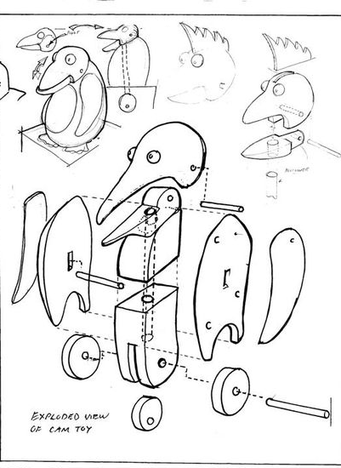
Home Learning 5: Modification of ideas | Draw your modification below: | The image above shows you a hand sketch of a final idea with small images explaining how it works. You need to do this and include notes on how you have modified the design on the sketch
Now you have completed your design product you need evaluate it and suggest modifications Modifications are what you would do if you could do the project all over again In the space on the right draw out your design but showing what you would do differently if you could do it again using arrows and labels
What you could say:
Would you have planned your templates more carefully? Would you have used the dowel joints differently? Would you have joined the product differently Would you have changed the template shapes? Would you have cut and finished more carefully?
Teacher Assessment: | WWW: | EBI:
Self Assessment: | WWW: | EBI:

