Slide 1

Year 9 Home Learning
"Aspiration"
NAME:
CLASS:
TEACHER:
Home Learning expectations
- All work is written or drawn by yourself, in your own words.
- Completed by the due date.
- Finished to the best of your ability.
- Clearly read and followed the instructions.
- Green penned and improved where needed.
- Peer or self-assessed when asked to.
- Presented so it is clear and neat.
- Work has been proofread to ensure spelling, punctuation and grammar is to the best of your ability.

Slide 2
Need Help? Read This First
Art is about developing skills, solving problems and learning from mistakes. If you get stuck, try the suggestions below before asking for help.
What to Do if You Are Stuck
Read the task carefully and identify what you need to do.
Break the task into small steps and complete one at a time.
Use the examples and images provided.
Spend at least 10 minutes attempting the task before stopping.
Focus on effort and improvement rather than perfection.
Compare your work to the success criteria, not to other students' work.
Ask yourself: What is the next small step I can complete?
Drawing Tips
Start with simple shapes.
Draw lightly so mistakes can be corrected.
Look carefully and draw what you can see.
Check sizes and proportions.
Add details gradually.
Use light and dark tones to show form.
Shading Tips
Start lightly and build up darker tones.
Look for highlights and shadows.
Use smooth pencil strokes.
Build tone in layers.
Practice creating a tonal scale from light to dark.
Research Tips
When researching an artist, designer or movement, find out:
Who they are.
When and where they worked.
What materials or techniques they used.
What inspired their work.
Why their work is important.
Always write in your own words and use short notes rather than copying information.
Writing Tips
Use full sentences.
Check spelling and punctuation.
Read your work back to yourself.
Make improvements where needed.
Before You Hand In Your Work
Check that:
You have completed all parts of the task.
Your work is neat and clearly presented.
You have included enough detail.
You have used a range of tones where appropriate.
Your research is in your own words.
You have checked spelling and punctuation.
You have acted on any feedback given.
Getting Help
If you are still unsure, ask:
Your teacher.
A classmate.
A parent or carer.
The school library or online learning resources.
Remember: Every artist improves through practice, effort and perseverance. Keep going and do your best.

Slide 3
Task: Word and Text in Art Title Page
WORD AND TEXT IN ART
• Create a title page for your first project.
• Draw at least 4 examples of text based art with detail in the box provided
• You will need to look up images of this kind of art.
WWW:
EBI:

Slide 4

Task: Bob and Roberta Smith Research Page
Using the space provided, create a research page about the artist and their text based work .
Artist Biography:
A close-up tonal drawing of a letter:
A detailed tonal pencil drawing of the picture:
WWW:
EBI:

Slide 5


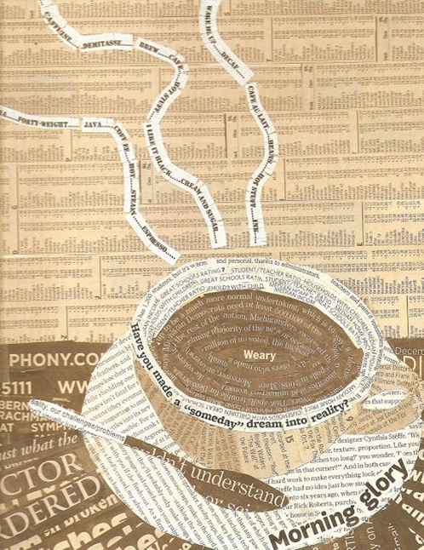

Task: Text Based Collage
Create a collage of letters from newspapers and magazines
Make a statement, quote a song lyric, write a poem, or simply write out your favourite word
Think about composition, colour, shape and placement – make it visually exciting!

Slide 6
Task: Text Based Collage
WWW:
EBI:

Slide 7
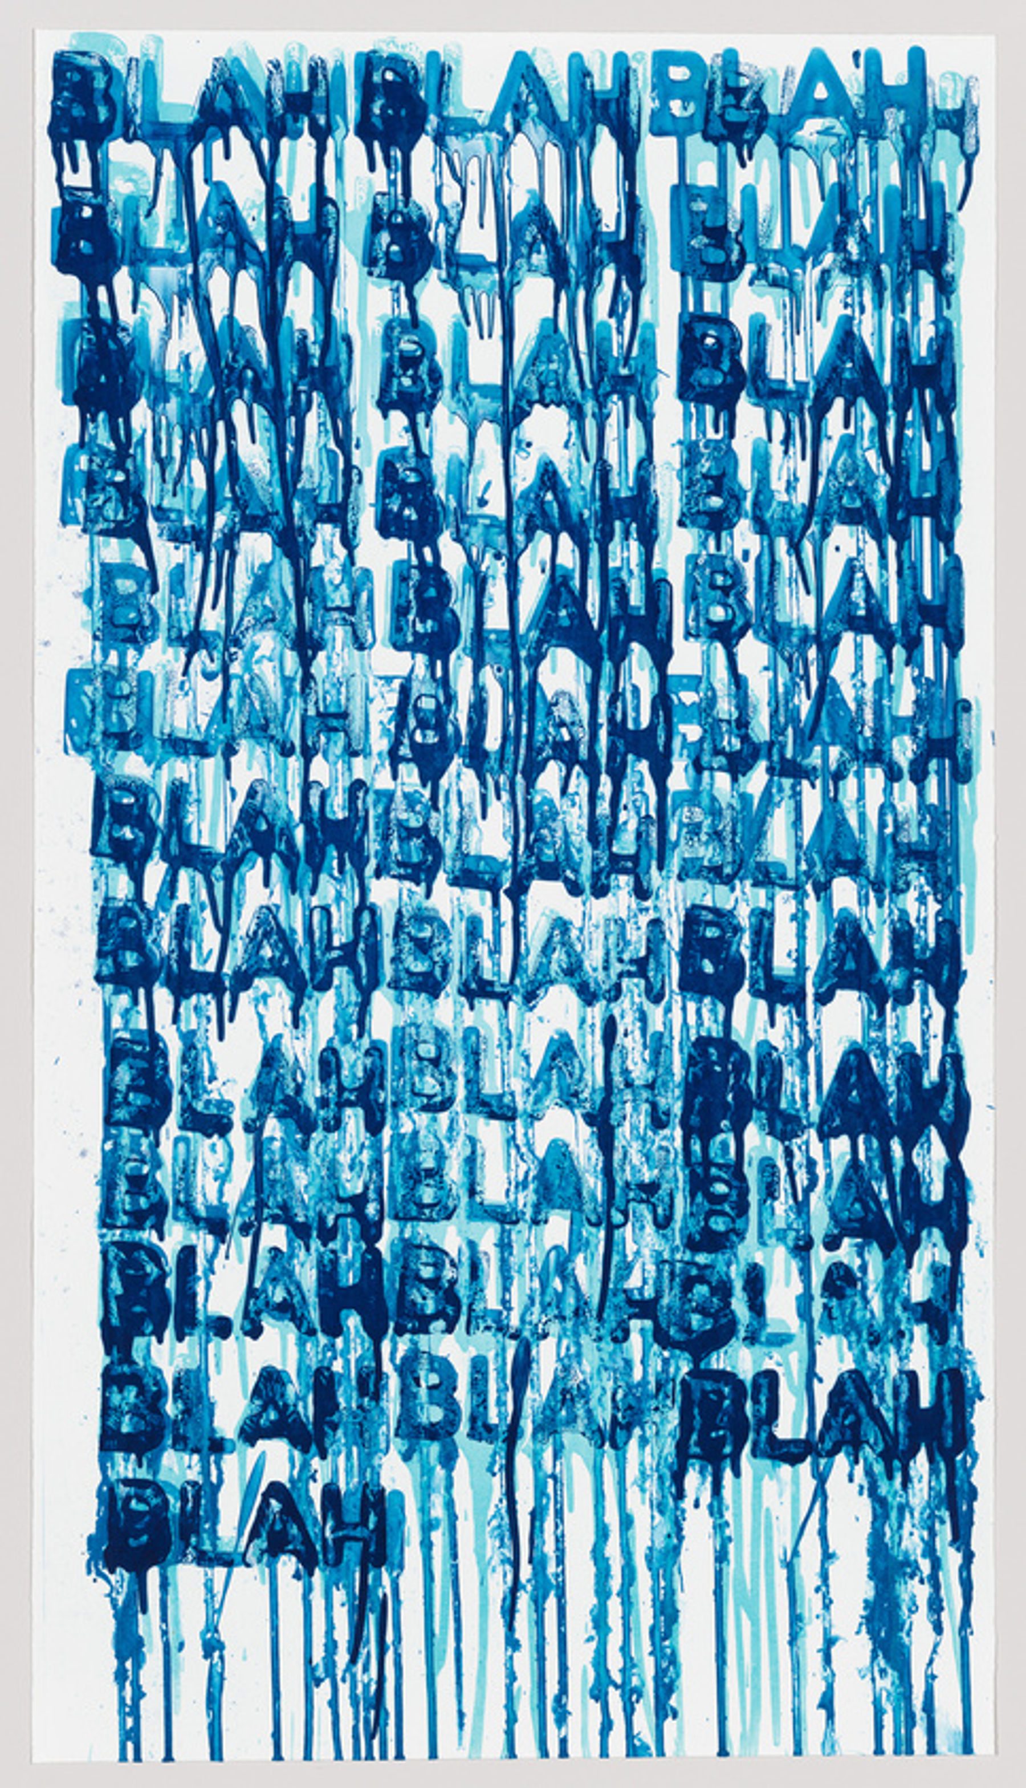
Task: Graphic Design Research Page
Using the space provided, create a research page about the role of Graphic Designers in Art .
What is a Graphic Designer?
What is the meaning or message of the piece in box 2?:
Design your own text-based response in the artist's style:
WWW:
EBI:

Slide 8

Task: Emmet McBain Research Page
Using the space provided, create a research page about the artist and their text based work .
Artist Biography:
A close-up tonal drawing of a letter:
A detailed tonal pencil drawing of the picture:
WWW:
EBI:

