Slide 1

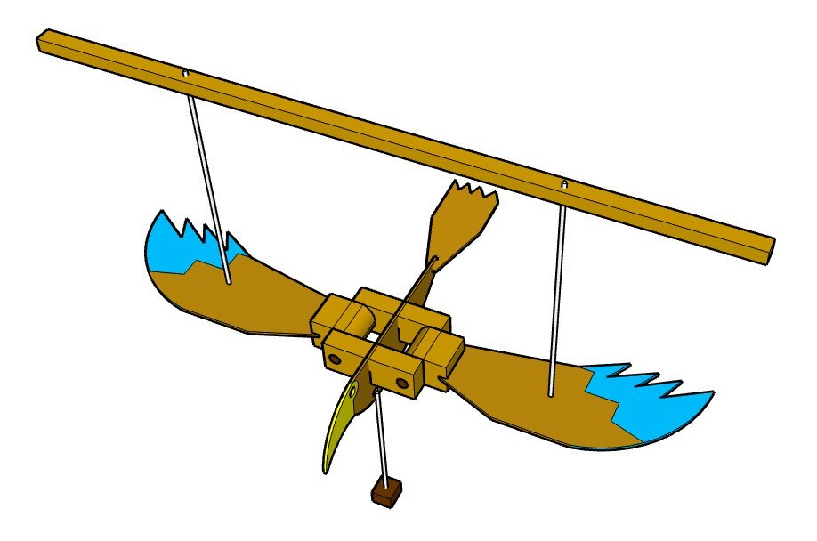
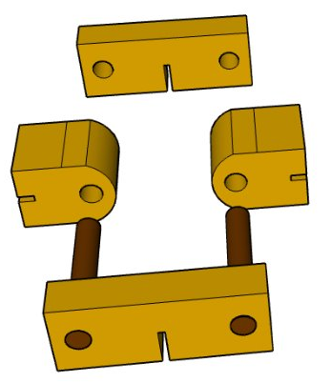


Year 9 Design and Technology: CAD/CAM Mechanisms | Your Name:
Home Learning Booklet | Teachers Name:
Autumn Term | Class Code:
Home learning expectations: Work must be drawn or written by yourself, in your own words. Completed by the due date. Finished to the best of your ability. Closely follow the instructions. Green penned and improved when needed. Peer or self-assessed when asked to. Presented so it is clear and neat Proof-read the work to ensure spelling, punctuation and grammar is to the best of your ability.
ASPIRATION

Slide 2

Home Learning Task 1: Ideas research
To design your Flight Mobile you are going to need images that you can use for inspiration On this page arrange at least 20 images from a range of creatures use a mix of real imagery and illustrations so that you have variation to work from.
Teacher Assessment: | WWW: | EBI:
Self Assessment: | WWW: | EBI:

Slide 3
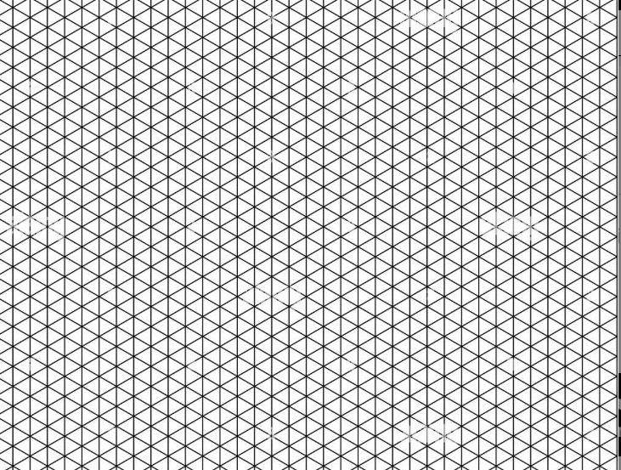
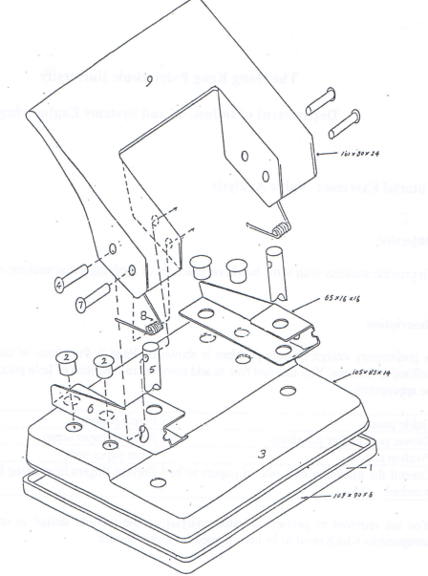
Home Learning Task 2: Design Ideas
You need to complete at least 3 different design ideas for your flight mobile project on the plain A4 paper you were given Your designs need to include 'exploded diagrams' which show how the wings and body will fit together. There are examples of crating and exploded diagrams on the right
You Must:
Use the isometric method for at least 1 of the design concepts Complete 3 different ideas from your chosen theme Remember one idea is not just one drawing - it is several labelled diagrams
You can use the 'crating method and you should try 'exploded diagrams'
Teacher Assessment: | WWW: | EBI:
Self Assessment: | WWW: | EBI:

Slide 4
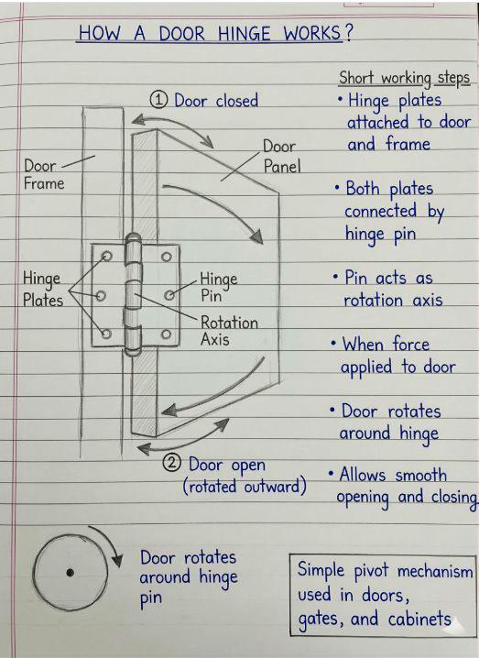
Home Learning Task 3: Mechanisms
In the space on the right draw a diagram of a rotating mechanism using a pivot from home Remember a pivot can be a large or small component in the mechanism ​ Use the diagram of how a hinge works below to help you lay out your diagram neatly.
Do your diagram of your mechanism here.
Teacher Assessment: | WWW: | EBI:
Self Assessment: | WWW: | EBI:

Slide 5
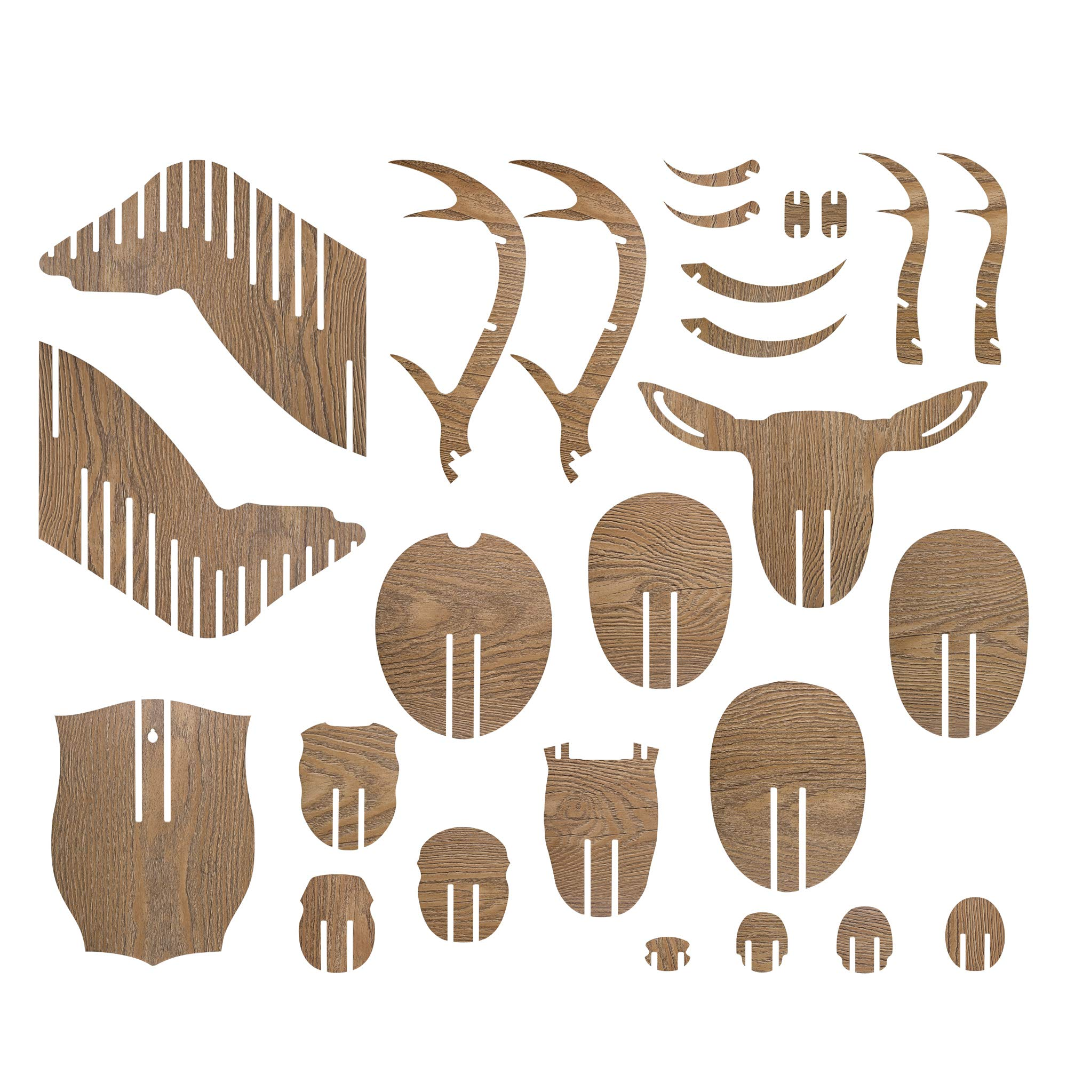
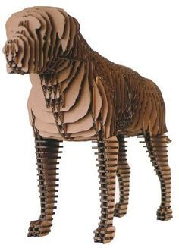
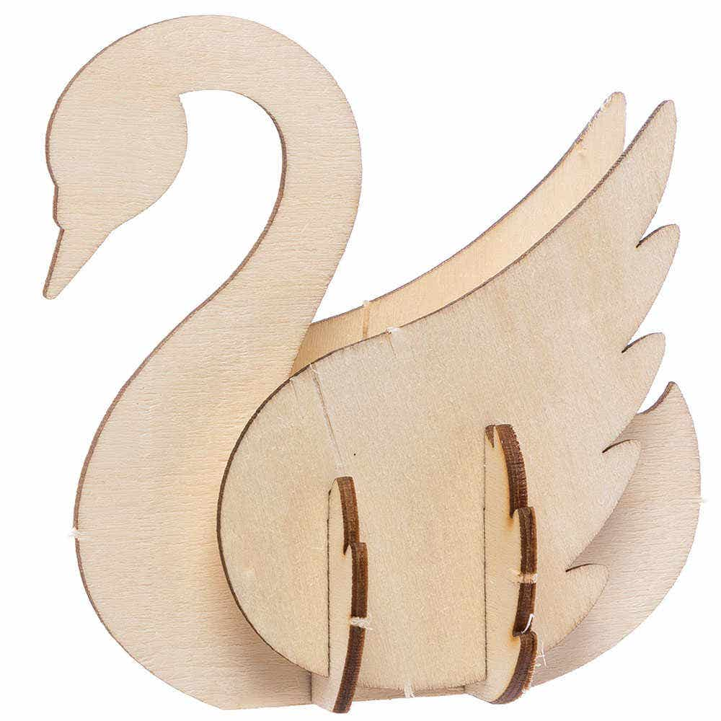
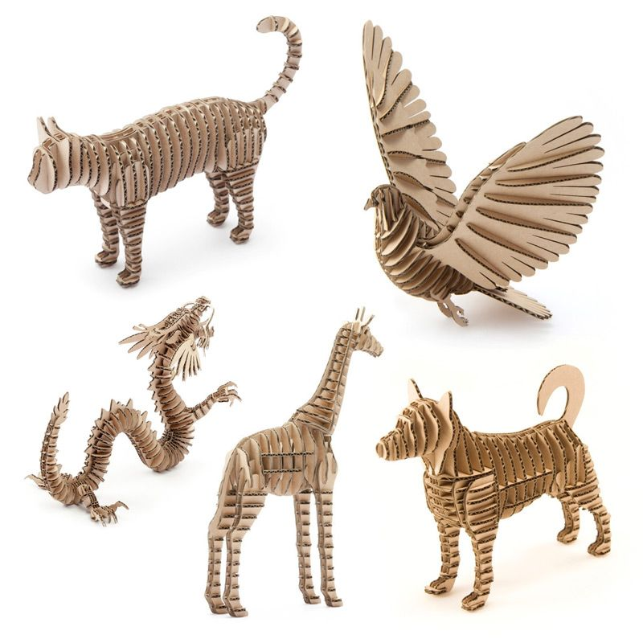
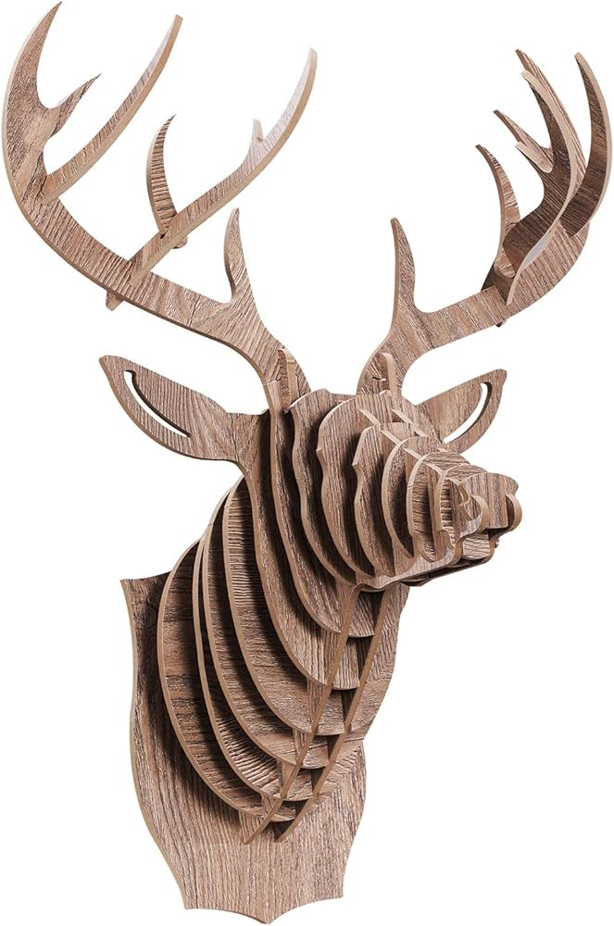
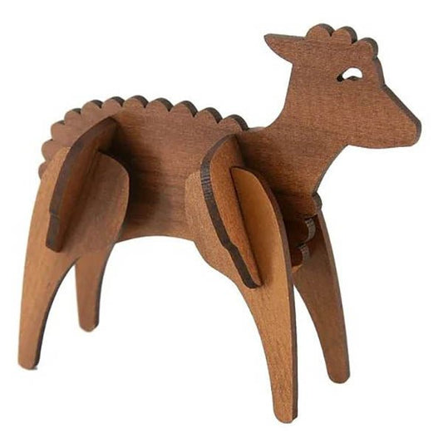
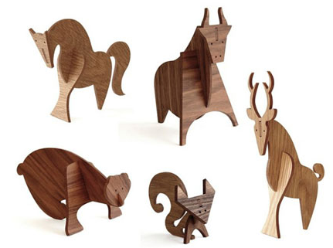
Home Learning Task 4: Slotting toy concept | Inspiration for your 'slotting' animal
Now you have completed your first design ideas you need to adapt them to look 3 dimensional Using card you have been given or from what you can find at home, make a 'slotted' animal (the slots lock the pieces together). Choose one of the examples or make your own
Teacher Assessment: | WWW: | EBI:
Self Assessment: | WWW: | EBI:

