Slide 1
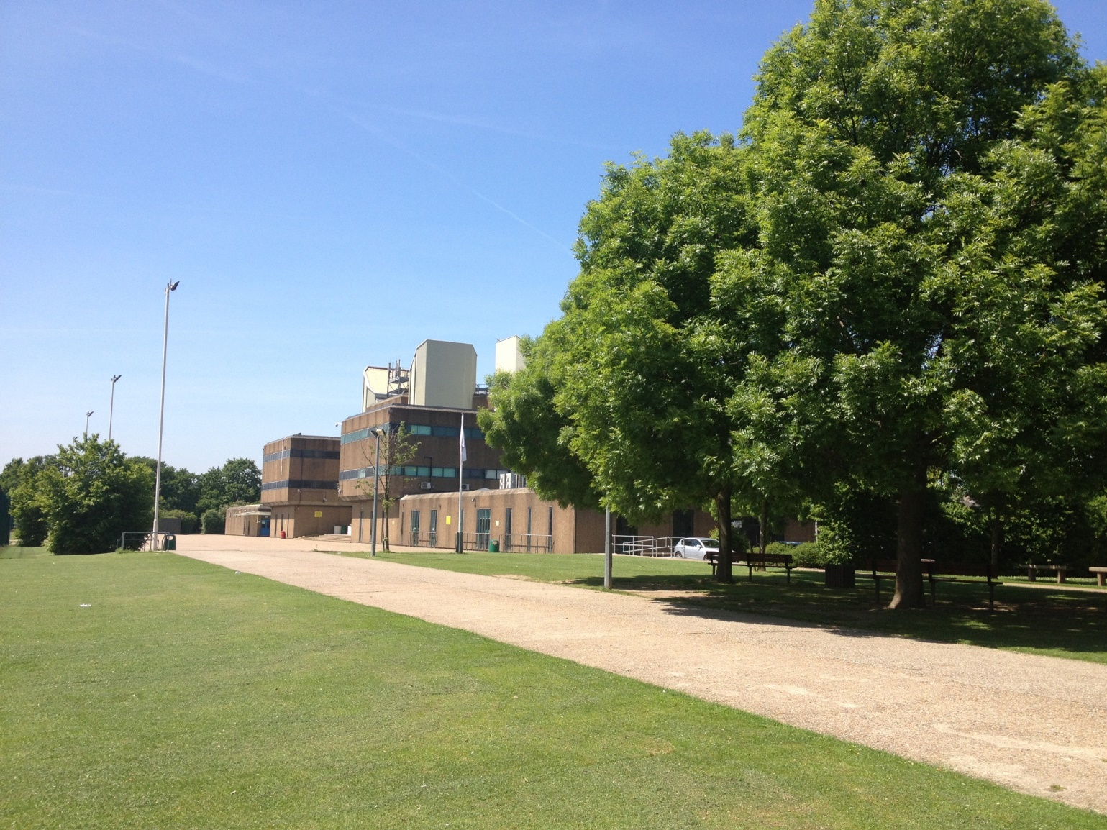

Ks4 information evening learning support
Welcome to The Heathland School
‘An outstanding school’
Wednesday 30.09.2026
AW
ECF

Slide 2
Format of the evening
The Team
SEND at The Heathland
Access Arrangements
Questions

Slide 3

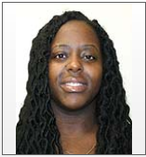

The Team
Mr Walters
Ms Lewis
Miss Chahal-Ferguson
Head of Learning Support
Deputy Head of Learning Support
Access Arrangement/ Specialist Teacher
Responsible for Year 9,10 and11
Responsible for Year 7 and 8
Responsible for Year 12 and 13

Slide 4

Waves of
Support
SEND at The Heathland
Student Requires specialist support to have their needs met
EHCP –
Specialist Support
Targeted Plus
Targeted
Ordinarily Available Provision
Needs can be met with quality first teaching

Slide 5
Waves of
Support
SEND at The Heathland
Support delivered in line with their legal document
Student Requires specialist support to have theirs needs met
Support delivered in line with their legal document
Support given specifically for the student to help improve their area of difficulty (intervention)
Additional Classroom support such as visuals tailored to the specific student
Support given in the classroom through resources and delivery
Needs can be met with quality first teaching

Slide 6
Examples of Provision
Smaller class sizes
Phonics and reading interventions
Specialist teachers
Fidgets, reading aids or wobble cushions
Access to the sensory spaces
Time-out pass
Small group TA work
Occupational Therapy
Speech and Language Therapy
Learning Mentors

Slide 7
Understanding Access Arrangements
A Quick Guide for Parents

Slide 8
What Are Access Arrangements?
Adjustments that enable students with additional needs to access exams fairly.
Must be supported by evidence and meet JCQ requirements.
Notes:
Access Arrangements are adjustments that help a child show what they can do in tests or exams without giving them an unfair advantage.
They are not about making the work easier — just about removing barriers caused by a learning difficulty or disability.

Slide 9
Common Access Arrangements
Extra time (typically 25%)
Reader (someone reads the question aloud)
Scribe (someone writes what the students says)
Rest breaks (supervised) – Rules
Use of a laptop (handwriting analysed)
Modified/enlarged papers for visual needs
Prompting for focus and task management
Alternative rooming arrangements, JCQ guidance is clear: “general anxiety or nervousness about sitting examinations” is not sufficient grounds.
Notes:
JCQ Joint Council for Qualifications+2JCQ Joint Council for Qualifications+2
Because access arrangements must reflect the student’s normal way of working, if the student does not routinely sit exams in a separate room or have invigilation supports during mocks or class assessments, then separate room cannot legitimately be justified. JCQ Joint Council for Qualifications+2disabilityrightsuk.org+2
In practice, schools often treat requests for separate room or 1:1 invigilation only in “exceptional circumstances” — such as serious medical needs — rather than for common pre-exam worry or anxiety. louisedawson.com+2lordwilliams.oxon.sch.uk+2
Since my anxiety does not amount to a long-term impairment,

Slide 10
Who can get Access Arrangements?
Not every child with SEND will need access arrangements. To qualify, we must show:
    The student has a long-term difficulty that affects their normal way of working.
    Arrangements are regularly used in lessons (NWOW).
    Meet the official criteria set by exam boards and JCQ.
Notes:
Schools can not give access arrangements unless they have evidence that it us genuinely needed and not just a want.

Slide 11
Decisions/Process of Access Arrangements
Teacher Observations – noticing patterns in classwork/homework
Teacher Referral forms and gathering of evidence
Screening and assessments begin in Summer term of Year 9 to identify needs early (ready for KS4).
Once approved, arrangements last for 26 months.
This means they continue through Years 10 and 11, covering GCSE exams.
Notes:
Schools current decision/ process of Access Arrangements?
5. How does the school decide if an access arrangement is needed?
The process usually involves:
Teacher observations — noticing patterns in classwork.
Gathering evidence — classwork, assessments, reports.
Specialist testing (for secondary exams) — usually done by a qualified assessor.
Decision-making based on official regulations.
Applying to the exam board where needed.
You will be informed of any arrangements put in place for your child.
Our Process for Access Arrangements
Teachers identify concerns or barriers
SENCO gathers evidence from:
classwork
assessments
observations
specialist reports
If needed, your child will complete assessments with a qualified assessor
Decisions follow national exam regulations
We inform parents before arrangements are finalised
Access arrangements used in class will be mirrored in exams

Slide 12
JCQ Compliance – What This Means
All arrangements must follow Joint Council for Qualifications regulations.
Evidence must include: testing scores, teacher input, history of need, specialist medical information (not from a GP).
Schools must demonstrate that support reflects classroom practice.
Arrangements are reviewed periodically.

Slide 13
How Parents Can Support
Share any relevant reports or external assessments with school.
Encourage students to consistently use arrangements in class/exams situations (even in mocks) and at home.
Early communication with the SENCo if concerns arise.
Notes:
You are key partners within this process and what you can do to support your child is:

Slide 14
Frequently Asked Questions
Will access arrangements disadvantage my child? – No, Access arrangements are simply there to make things fair, so your child can show their true ability.
Does my child automatically get arrangements? – No, evidence is required.
Can parents request access arrangements? – Schools must follow testing guidelines.
When will we be informed? – After testing and JCQ checks are completed a letter is sent out from the exams department.
Do arrangements apply to all exams? – For approved subjects.
Notes:
! St question - Will access arrangements disadvantage my child? - They do not change the difficulty of the test or guarantee higher makers.

Slide 15
You can also seek independent advice from
Your SENCO – Mr A Walters
SENDIASS – Free, impartial support for families
Local Authority SEND Team – Hounslow Council Website

Slide 16
Any Questions?

